Slide 1
Biochemical biomarkers of neurobiology of aging
Aurélie Ladang
aladang@chuliege.be

Slide 2
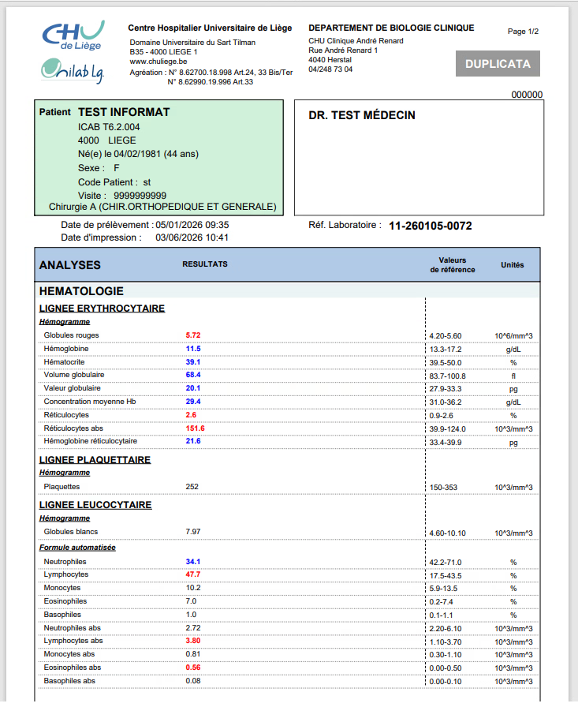
The concept of “reference ranges”

Slide 3
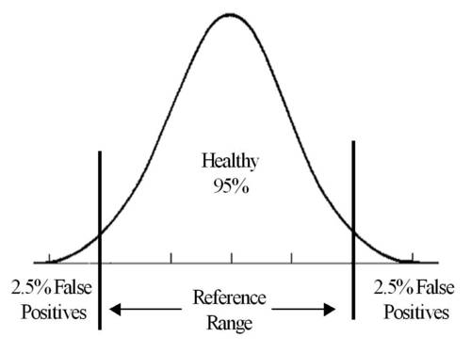
The concept of “reference ranges”
The concept of cut-off is distinct from the concept of reference ranges

Slide 4

The concept of “reference ranges”
Capturing diversity of aging to avoid misinterpretation in neurological biomarkers

Slide 5
Capturing diversity of aging to avoid misinterpretation in neurological biomarkers
Applied example
NfL for neuronal damage
pTau217 for Alzheimer’s disease
GFAP/UCH-L1 and S100b for mTBI

Slide 6
Neurological biomarkers: Neuron damage
Part of the axon
4 sub-units (Light, medium, heavy and variable)
=> Protein highly specific from the nervous system
Synaptic role
Axone component
Hygly expressed in long moto-neurons

Slide 7
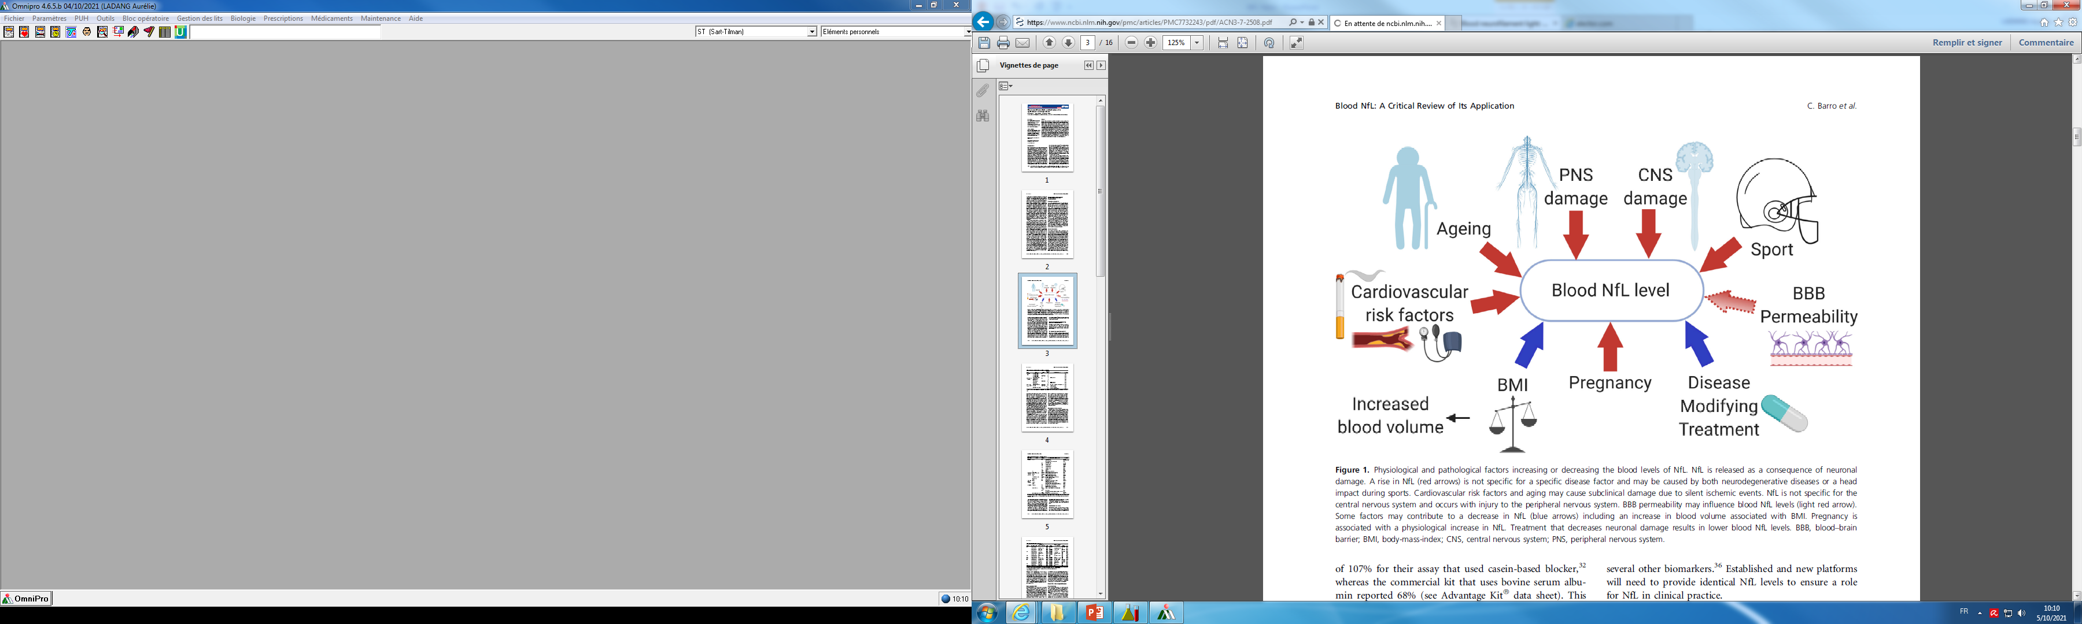
Neurological biomarkers: Neuron damage
NfL is used in routine in many different conditions
Follow-up of multiple sclerosis
Part of the diagnostic of ALS
Refinement of demantia diagnosis in case of negativity of main biomarkers
Follow-up after stroke
Barro et al., Annals of Clinical and Translational Neurology, 2020

Slide 8
Physiological variation of NfL
NfL is used in routine in many different conditions
Barro et al., Annals of Clinical and Translational Neurology, 2020

Slide 9
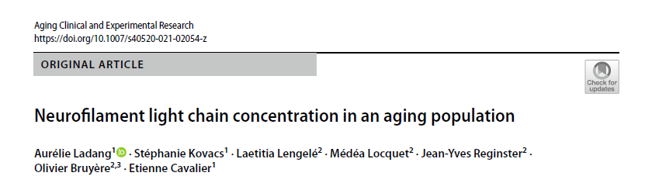
NfL during aging
Study on NfL concentration in aging individuals
  Cohorte SarcoPhAge
  Prospective longitudinal cohorte of aging subjects living at home
  No exclusion criteria beside limb amputation or BMI > 50 kg/m²
  409 séra collected at inclusion with sujets aged between 65 and 92 year olds
  Many démographique data
  More than 15 seld reported comorbidities

Slide 10
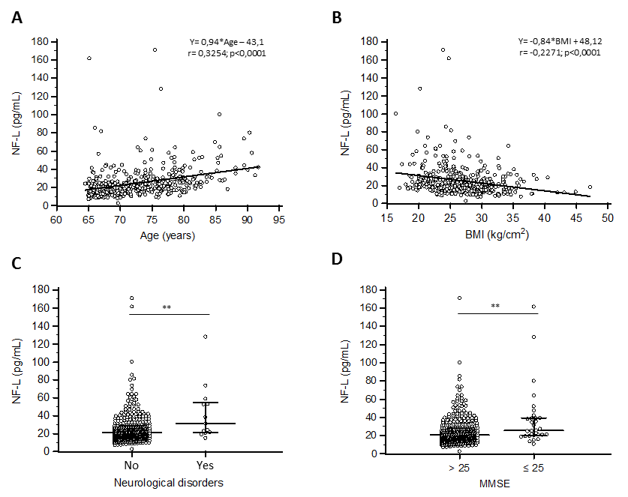
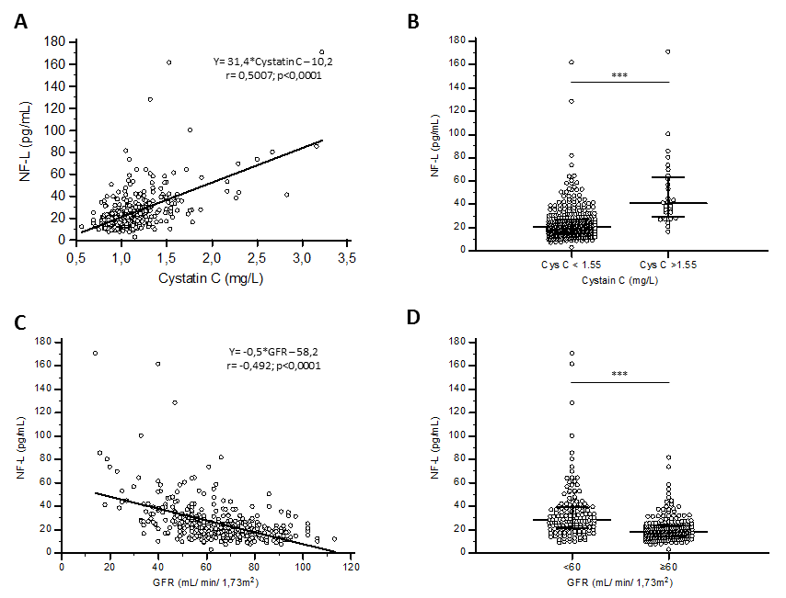
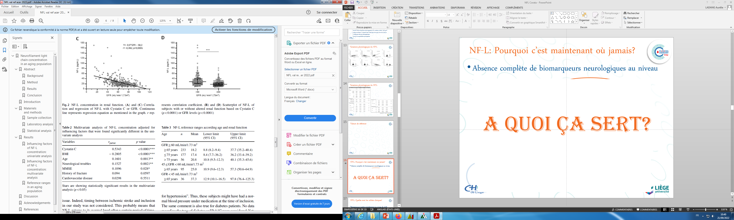
NfL during aging

Slide 11
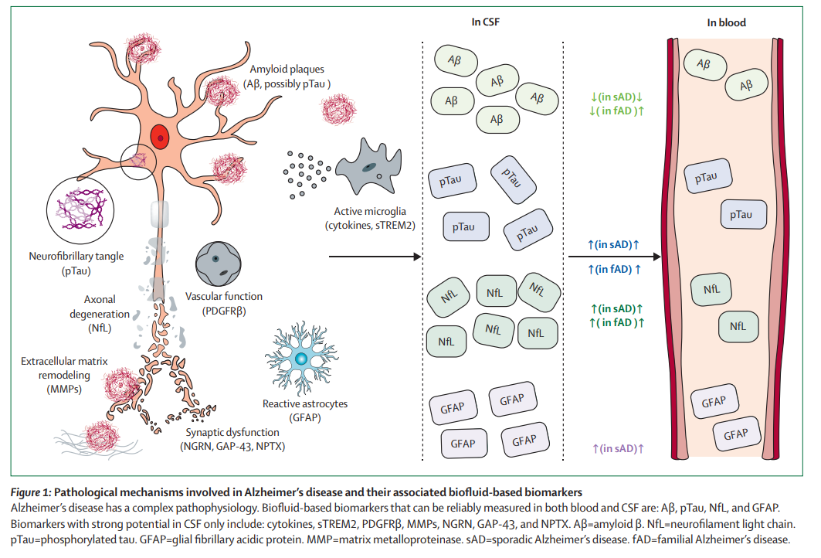
Neurological biomarkers: Alzheimer’s disease
C. Teunissen, Lancet Neurology, 2022

Slide 12
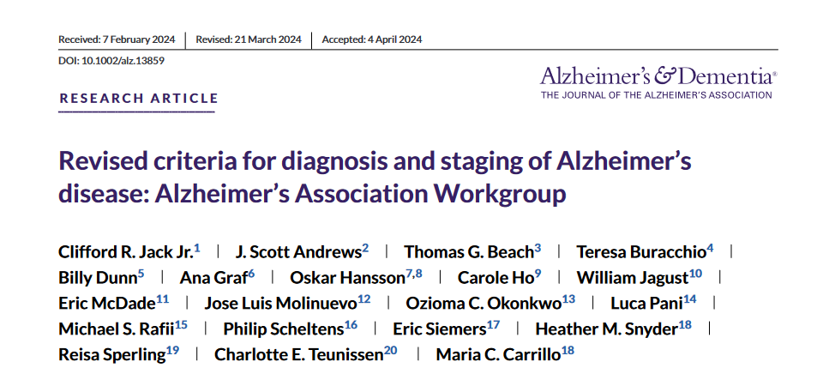
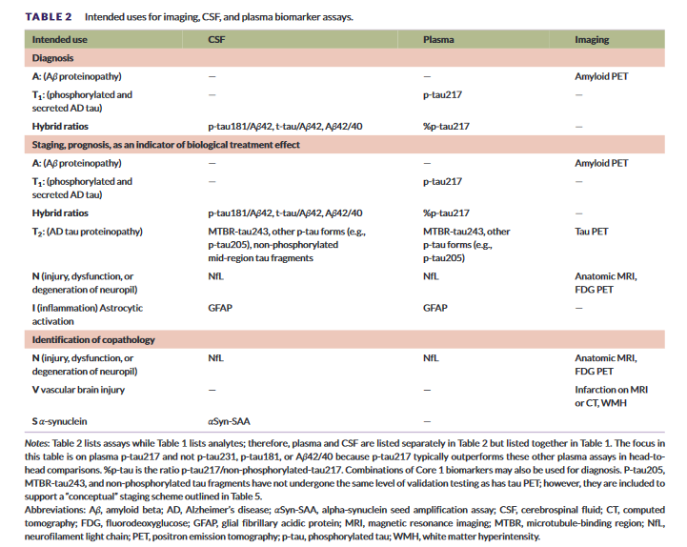
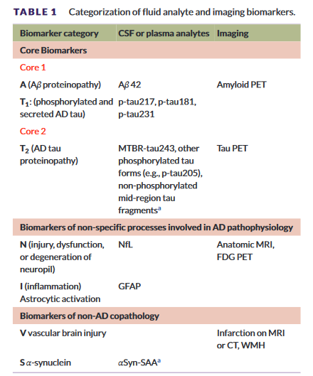
Towards a biochemical definition of Alzheimer’s disease?

Slide 13
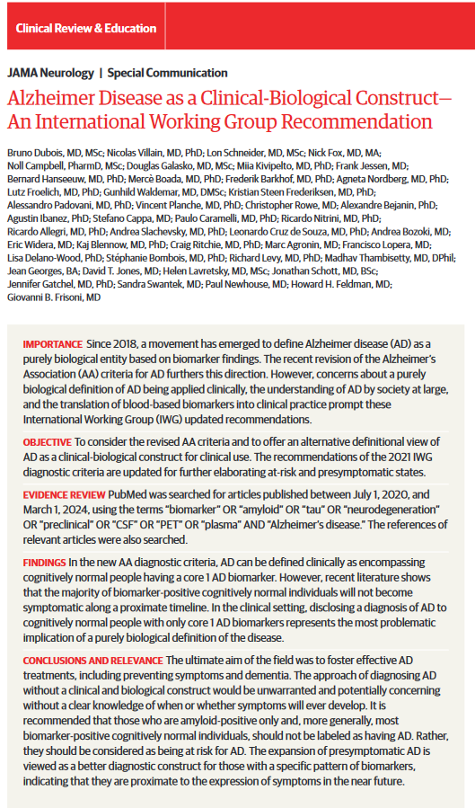
Towards a biochemical definition of Alzheimer’s disease?

Slide 14
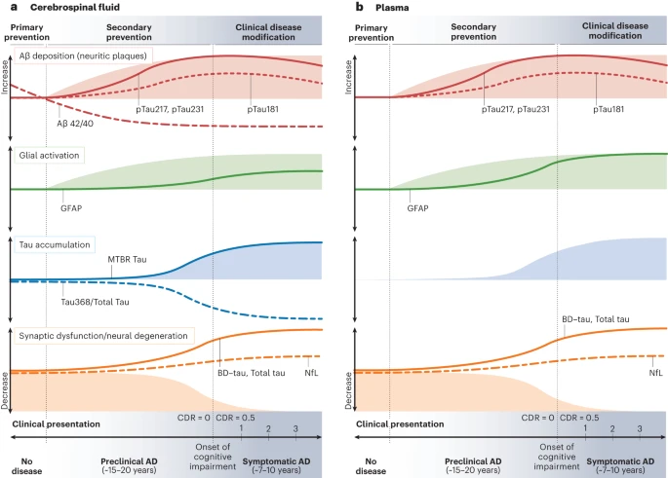
Towards a biochemical definition of Alzheimer’s disease?
W. Self, Nat. Med., 2023

Slide 15
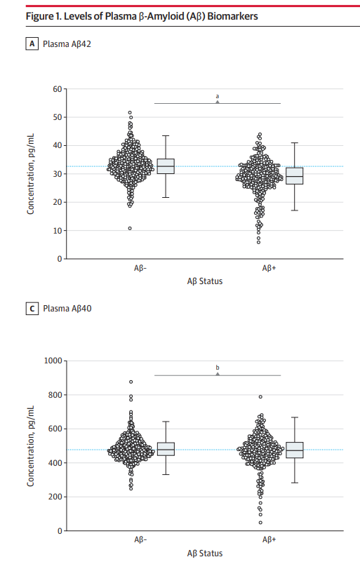
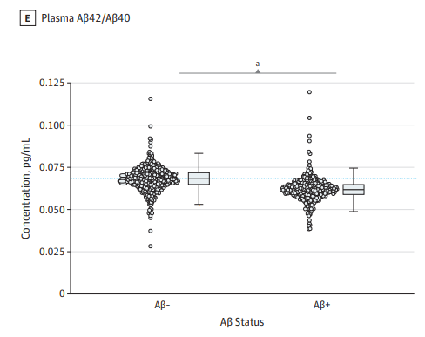
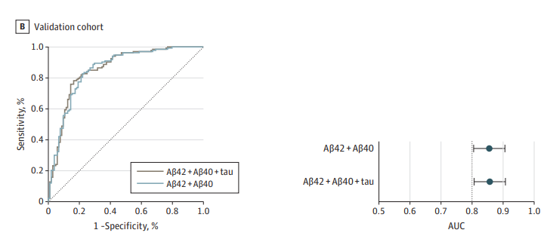
Amyloides β
Plasma Aβ regarding Aβ CSF status
S. Palmqvist, Lancet Neurology, 2019

Slide 16
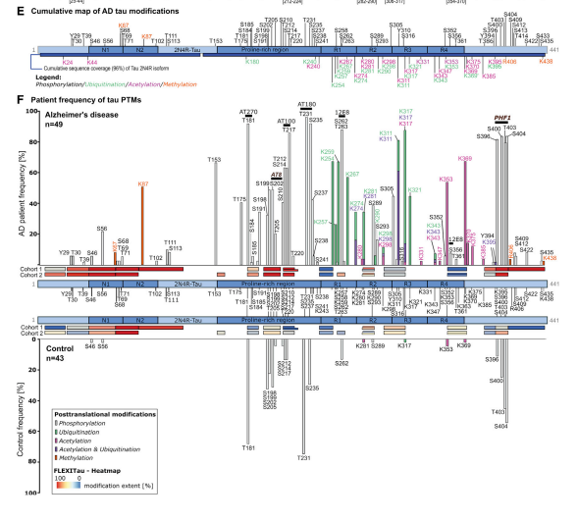
phosphoTau post-tranlational modifications
Which one choose?
H. Wesseling, Cell, 2016

Slide 17
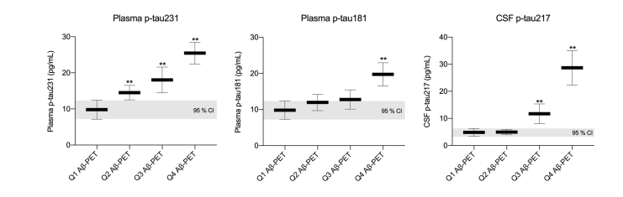
phosphoTau post-tranlational modifications
pTau regarding PET Amyloid
N. Ashton, Acta neuropathologica, 2021

Slide 18
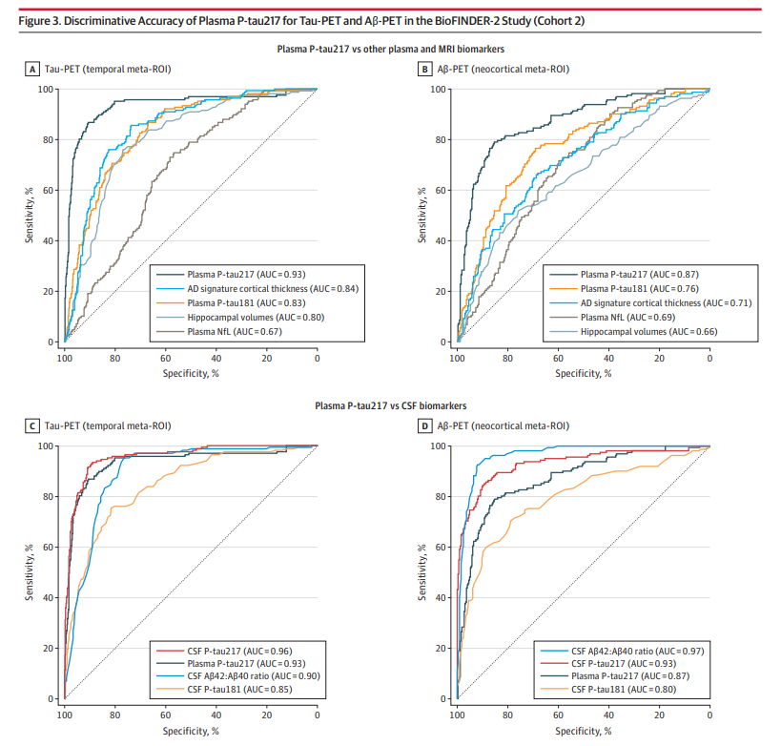
Isoformes de phosphoTau: pTau217 et pTau181
Plasma pTau217 regarding pTau181 regading PET and CSF
S. Palmqvist, JAMA, 2020

Slide 19
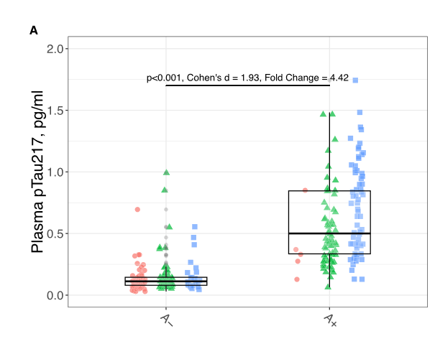
pTau 217 cut-offs
Selon Arranz et al.:
Sensibilité à 95%: 0,19 pg/mL
Spécificité à 95 %: 0,39 pg/mL
Définition d’une zone grise dans les protocoles

Slide 20
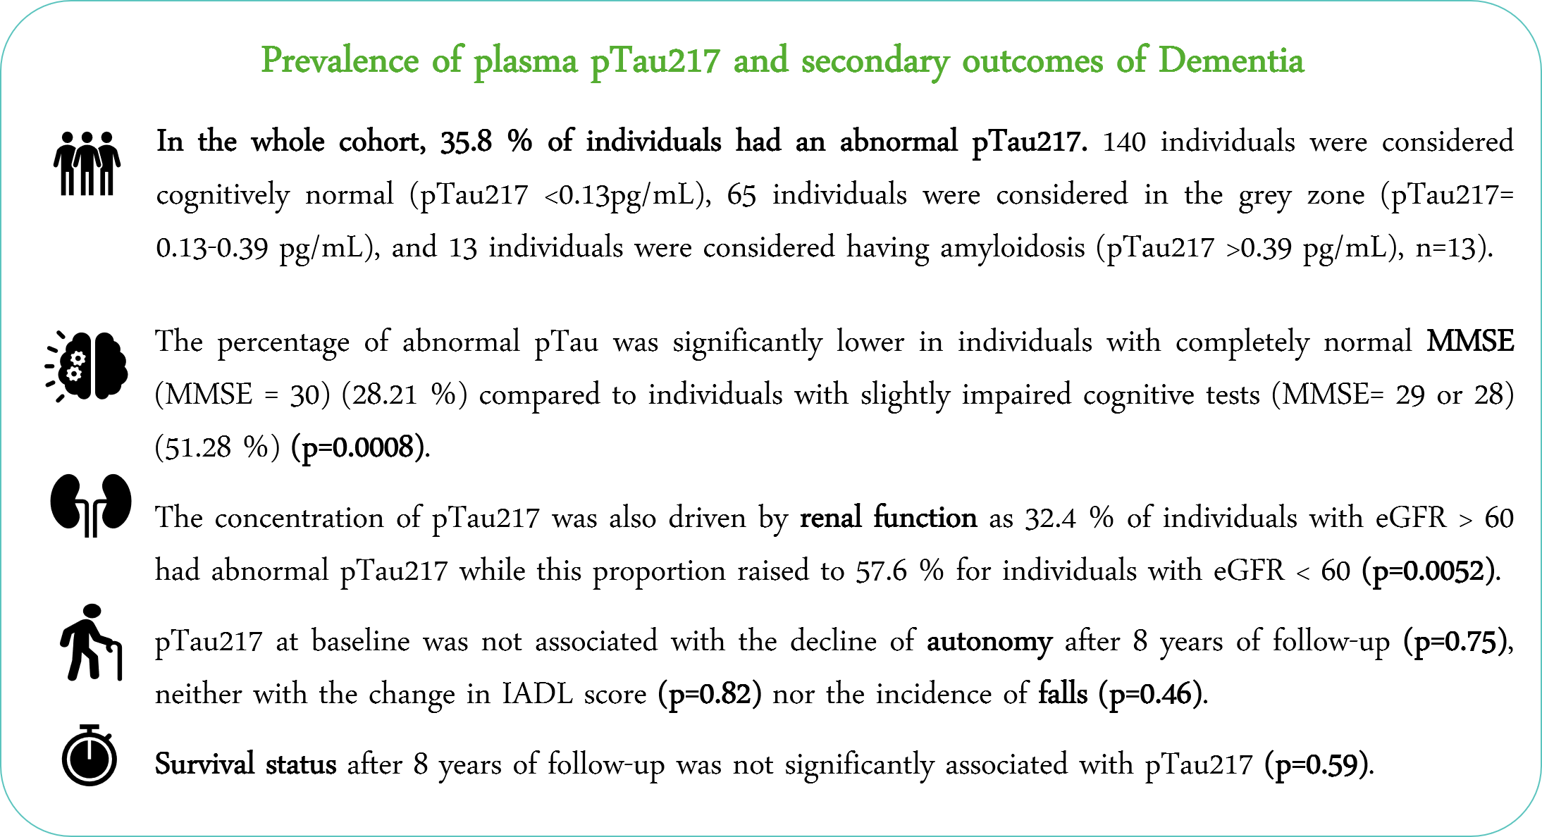
pTau 217 in unselected population
Results from the SarcoPhage cohort
Calluy et al., under submission

Slide 21
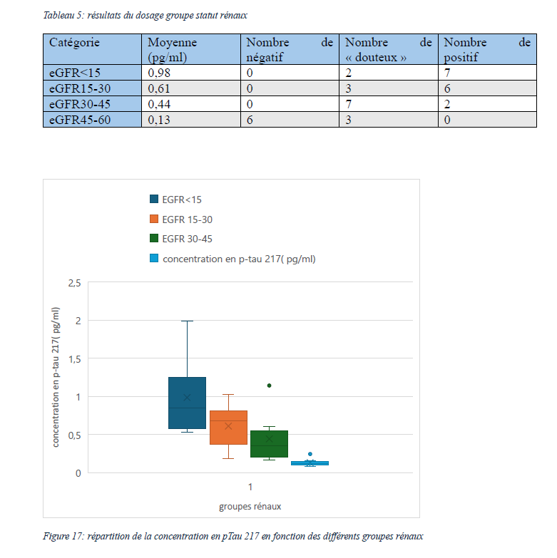
pTau 217 in patient with CKD
Results from internal validation

Slide 22
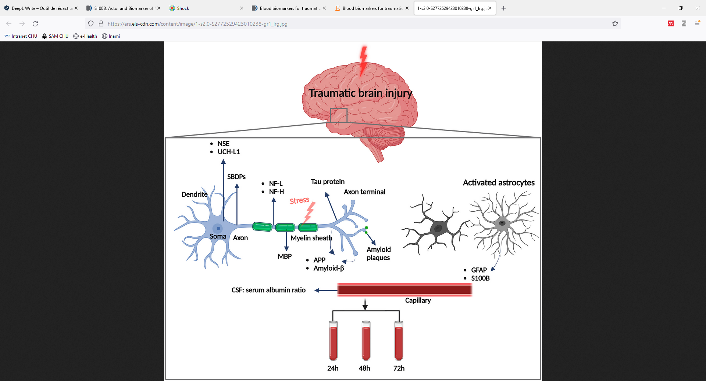
Neurological biomarkers: mTBI
NfL
GFAP/UCH-L1
S100b
Hossain et al., Bran and Spine, 2024

Slide 23
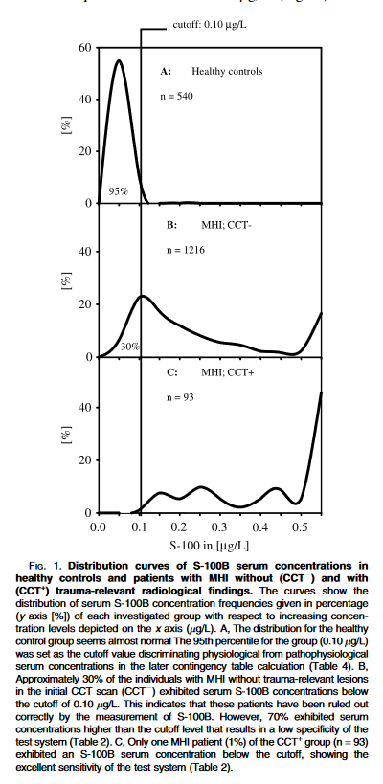
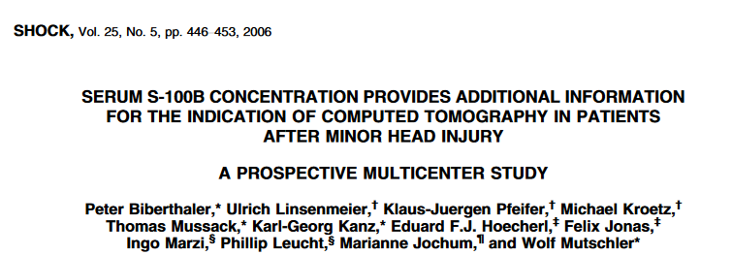
S100b for the rule-out of mTBI
S100b

Slide 24
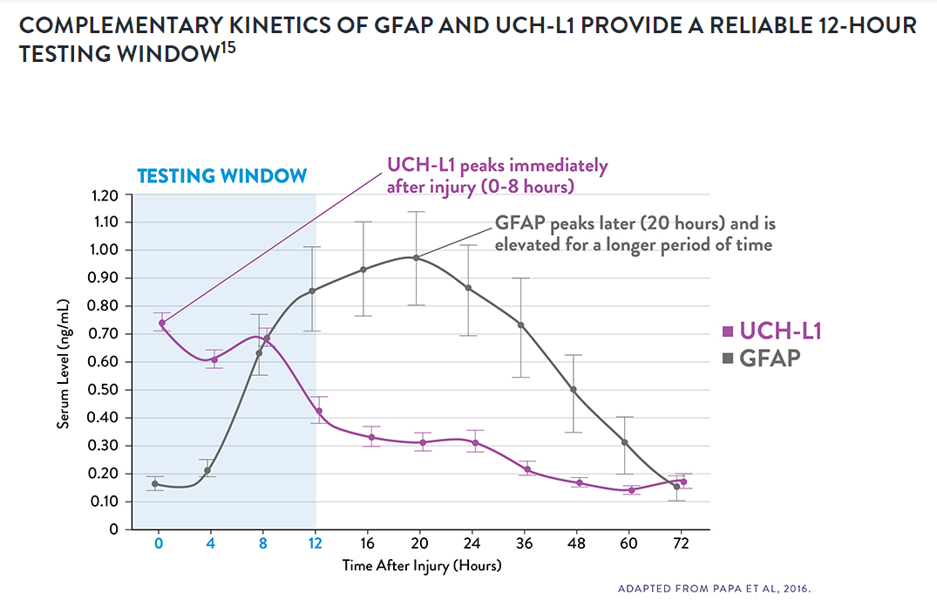
GFAP and UCH-L1 for the rule-out of mTBI
GFAP
=> semi-quantitative result
GFAP | UCH-L1 | Test result
Elevated | Elevated | CT scan needed
Elevated | Normal | CT scan needed
Normal | Elevated | CT scan needed
Normal | Normal | No mTBI
UCH-L1
Neuron cytoplasm damage

Slide 25
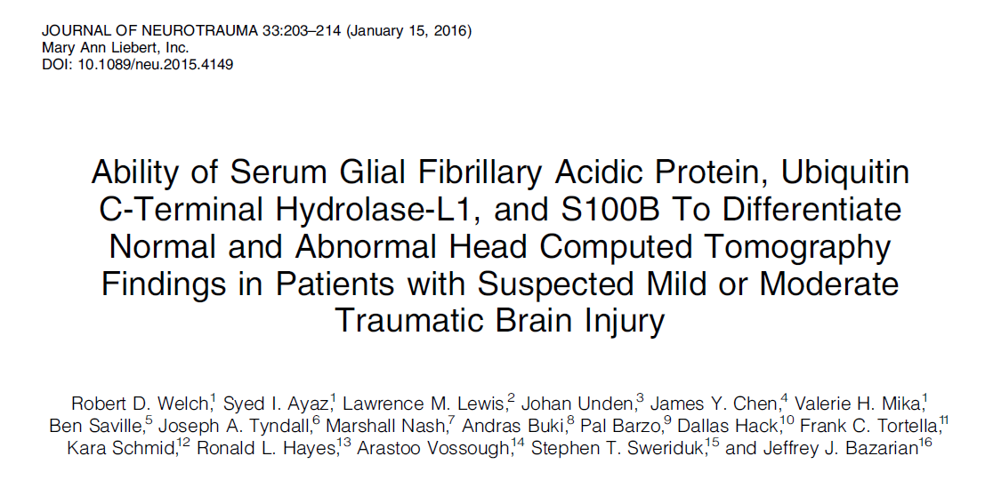
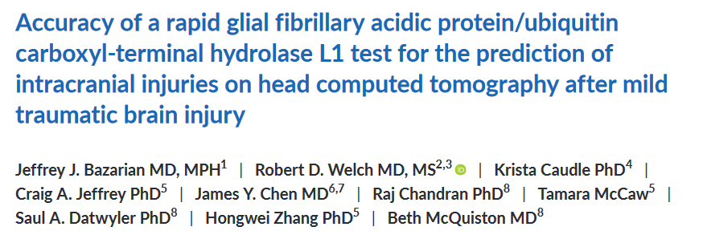
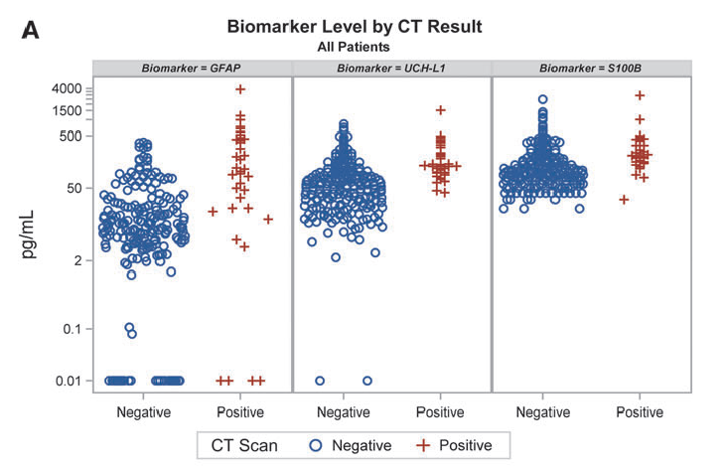
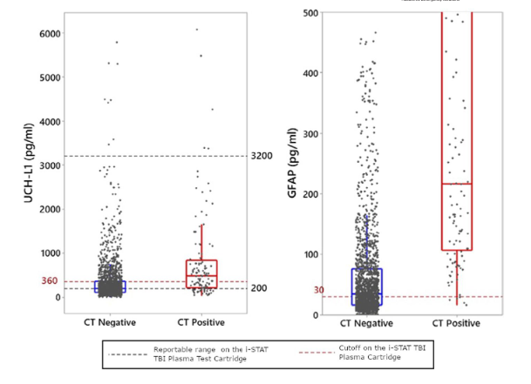
GFAP and UCH-L1 for the rule-out of mTBI

Slide 26
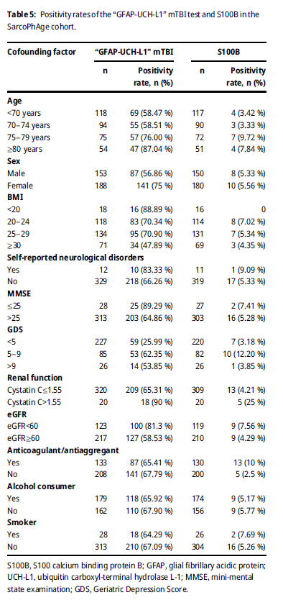
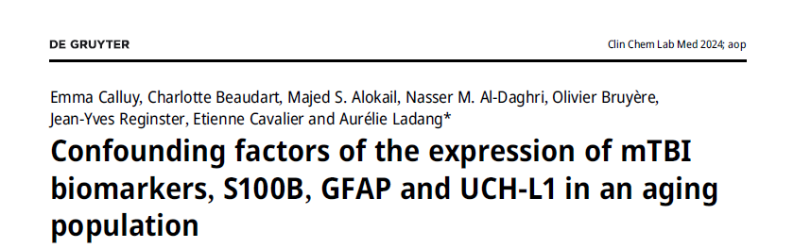
Study of the population at risk of mTBI to identify confounding factors
 | S100b | GFAP/UCH-L1
Age | √ | √
CKD | √ | √
BMI |  | √
MMSE |  | √
Anti-coagulant
Fractures | √
All kind of neurological troubles | √ | √
Calluy et al., CCLM, 2024

Slide 27
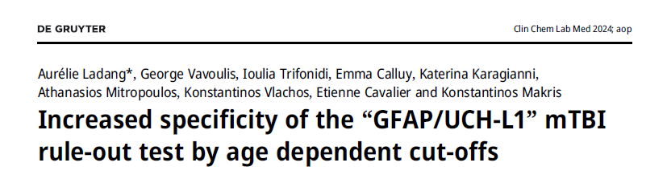
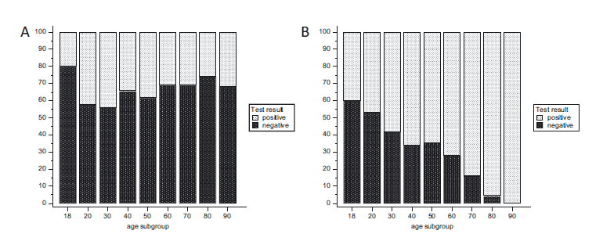
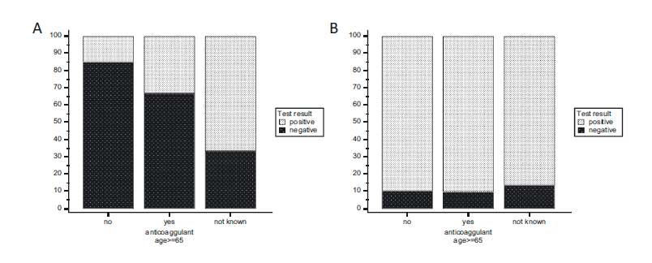
Cut-offs optimization based on confounding factors
Ladang et al., CCLM, 2024

Slide 28
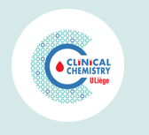
Research unit integrated in a routine lab
Deliver results for research with quality standard set-up for routine

Slide 29
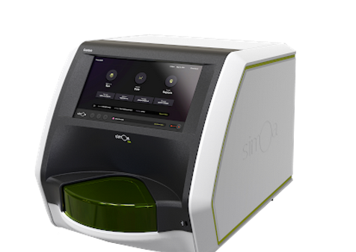
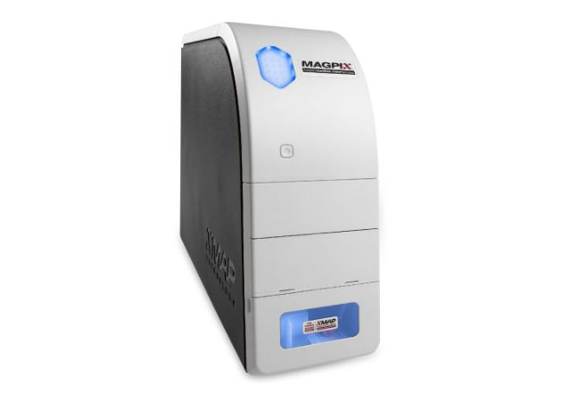
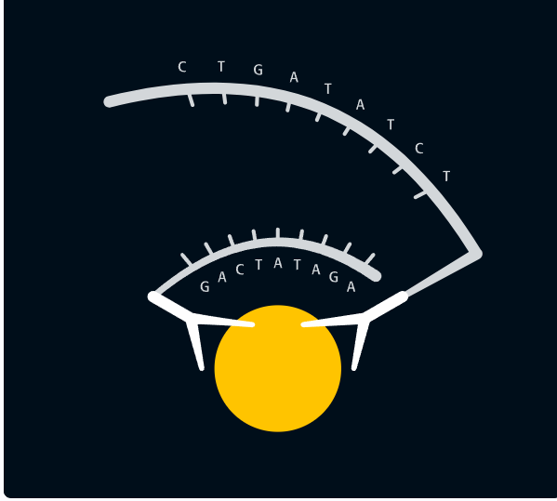

What we can offer
Clinical chemistry lab is equiped with the latest technologies in term of neurological BBBs
SiMoA Technology from Quanterix
PEA technology from Olink
Luminex technology
Quality insurance, Innovation and expertise

Slide 30
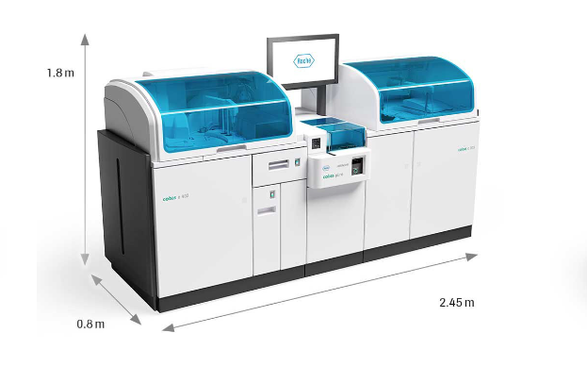
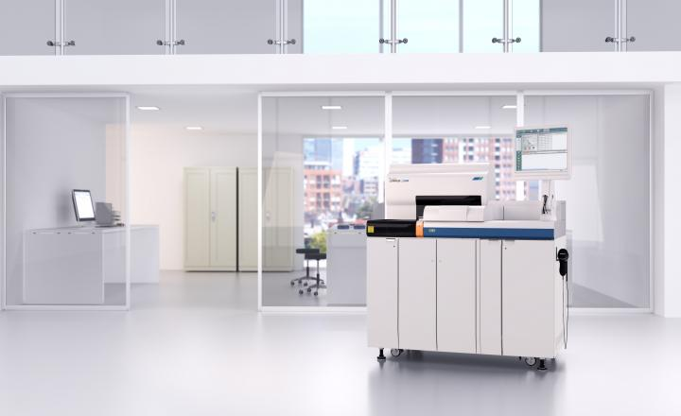
What we can offer
As a routine lab, we can offer a full panel of commonly used blood biomarkers in a BELAC ISO15189 certified lab
Lumipulse Technology from Fujirebio
Cobas Technology from Roche
Quality insurance, Innovation and expertise

Slide 31
Take-Home message
BBBs are not disease-specific. They are Brain-specific.
BBBs are influenced by many confounding factors:
  Aging
  BMI
  CKD
Some BBBs are already used in routine.
We are there to help you to choose
the right one for the right indication

Slide 32
Thank you for your attention
MiTicBrain Cohort
- Emma Calluy
Antoine Perot
All collaborating centers
SarcoPhAge Cohort
Charlotte Beaudart
Olivier Bruyère
Jean-Yves Reginster
Greek Cohort
Konstantinos Makris
George Vavoulis
Ioulia Trifonidi

