Slide 1
Neuroimaging and electrophysiology of the Association between Sleep and early onset Alzheimer’s disease
Overview
Introduction
Work Packages
Participants
Nasrin Mortazavi
Promoter: Gilles Vandewalle

Slide 2
Sleep and AD
Links between sleep and AD
Sleep : not identified as a risk factor for AD
Core sleep features not yet established.
Can we assess sleep – AD links in youth?
Participants
Introduction
Overview
Work Packages
2
Notes:
Altered sleep can promote AD pathology and AD pathology can promote altered sleep
#########
In late adulthood (> 50 y), the burden of Aβ and Tau aggregation, measured with PET has been associated with different sleep alterations including longer sleep latency and “shallower” sleep with less sleep slow waves. A lower amount of REM sleep has been reported to increase AD risk.
sleep contributes to Ab and Tau protein clearance.
sleep disruption increases Aβ and Tau concentration in cerebrospinal fluid.
2

Slide 3
Genetic Mutations lead to Early Onset AD
~ 100% certainty of EOAD
1% of AD cases
Neuropathology very similar to all AD cases
Mutations leading to EOAD:
Overview
Introduction
Work Packages
Participants
01
02
03
APP
PSEN1
PSEN2
Amyloid Precursor Protein
Presenilin1
Presenilin2
3
Notes:
Individuals who are born with these mutations have 100% probability to get AD before 65 years old.
Of course these mutations are rare and consist only 1% of all AD cases, but their neuropathology is very similar to all AD cases.
3

Slide 4
Participants
40 EOAD mutation carriers (APP, PSEN1, PSEN2)
40 non-carriers (Control group) [matched for sex, age and education]
18-45 years
Exclusion criteria:
Body mass index > 30 and <18
Depression, anxiety, addiction, other neurologic/ psychiatric disorders
Untreated diabetes, hyper/hypo tension/thyroidism
Cognitive impairment
Introduction
Overview
Participants
Work Packages
4
Notes:
mental and physical health
same participants

Slide 5
3 complementary work packages (WPs)
Introduction
Overview
Work Packages
Participants
WP1
Comparing sleep electrophysiology
WP2
Comparing 7T MRI of LC
WP3
Mediation
LC mediates the sleep differences?
5

Slide 6
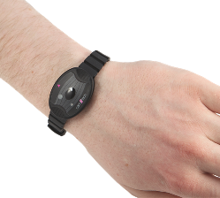
Electrophysiology of sleep – WP1
2 x overnight sleep under EEG
Main sleep features:
1) slow wave energy
2) sleep latency
3) sleep fragmentation
4) REM sleep duration
Secondary features, (e.g. Actimetry)
Overview
Introduction
Work Packages
Participants
Expected results: mutation carriers will have worse sleep.
6
Notes:
main sleep features of interest that might be associated with AD based on literature.
We expect that mutation carriers will have less deep sleep, more fragmented sleep, delayed sleep onset and less REM sleep.
6

Slide 7
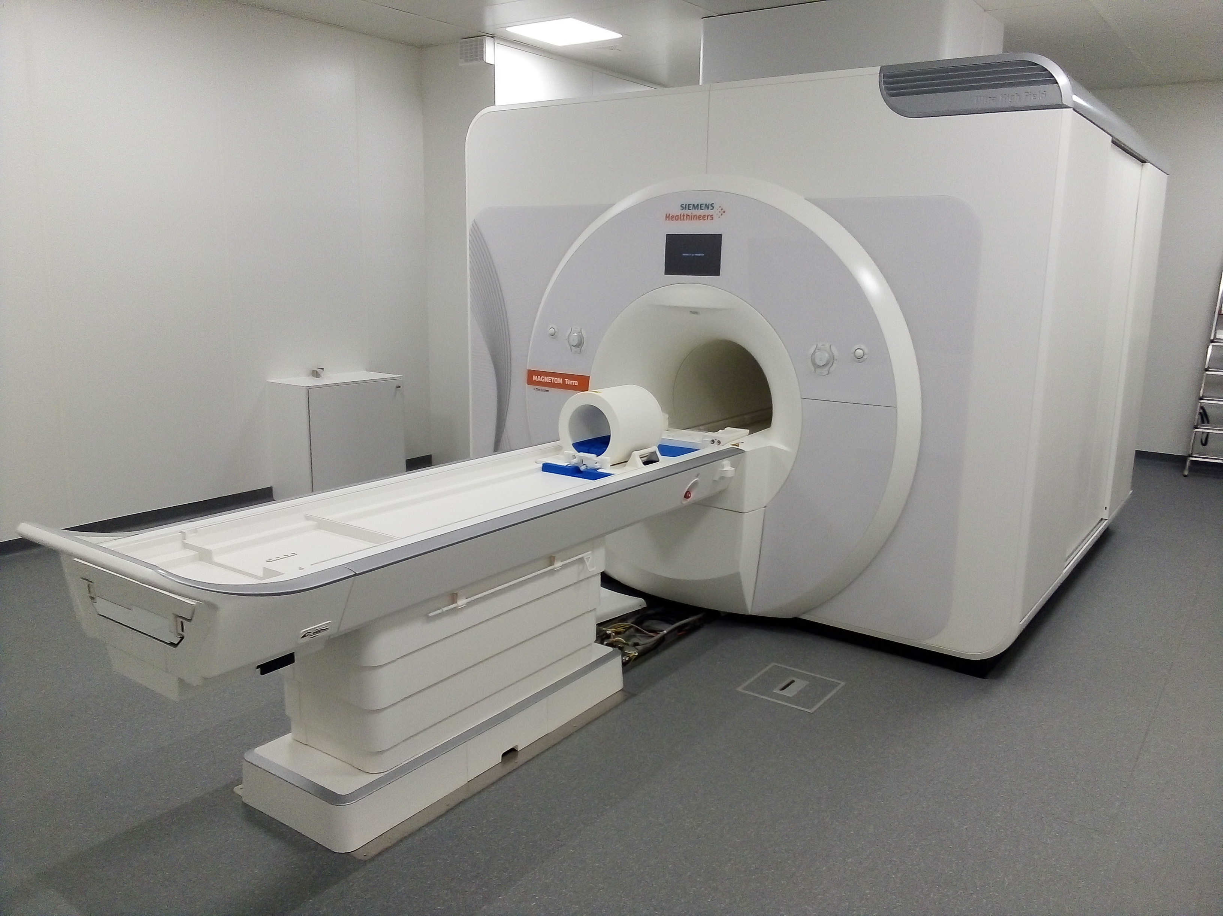
Ultra-high-field MRI of LC – WP2
High resolution 7 Tesla MRI at GIGA-CRC-IVI, Uliège
Main LC features:
Structure: 1) neuromelanin contrast 2) iron content
Function: 3) LC responsiveness in 2 tasks
[Perceptual and attentional tasks]
Introduction
Participants
Overview
Work Packages
Expected results: EOAD mutation carriers will have older LC.
7
Notes:
Main LC features that are associated with AD and aging based on literature.
neuromelanin contrast and iron content, which are the markers of AD and aging.
perceptual and attentional tasks that recruit LC.
7

Slide 8
Mediation – WP3
Do functional and structural characteristics of the LC mediate the sleep differences between EOAD mutation carriers and non-carriers?
Expected results: LC features would mediate the relationship between EOAD liability and sleep electrophysiology.
Introduction
Participants
Overview
Work Packages
LC
Sleep
EOAD
8
Notes:
In the third work package, we want to study whether structural and functional alterations in LC mediated the identified sleep differences between two groups.
We expect that LC would be responsible for part of the worse sleep among carriers.
8

