Slide 1
Brain information processing characterize Altered State of Consciousness:
a computational modelling framework
Rajanikant Panda
PhD Student
Coma Science group
GIGS-Consciousness, University of Liege, Liege, Belgium
Centre Du Cerveau², University Hospital of Liege, Liege, Belgium
Email: rajanikant.panda@uliege.be

Slide 2
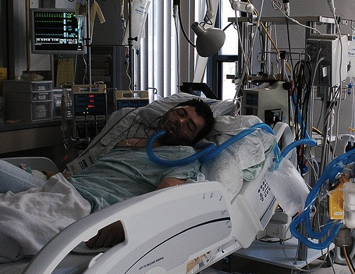
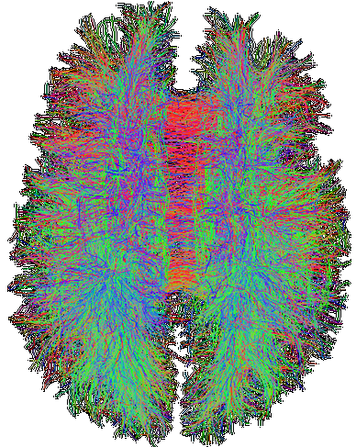
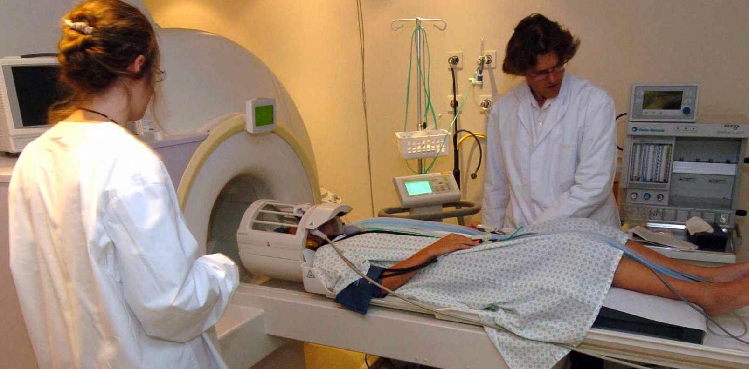
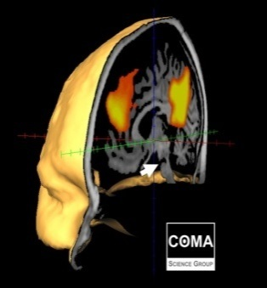
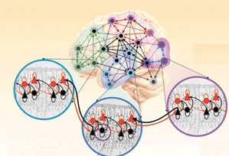
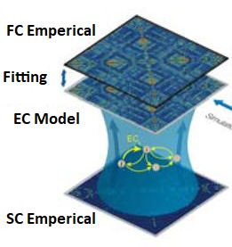
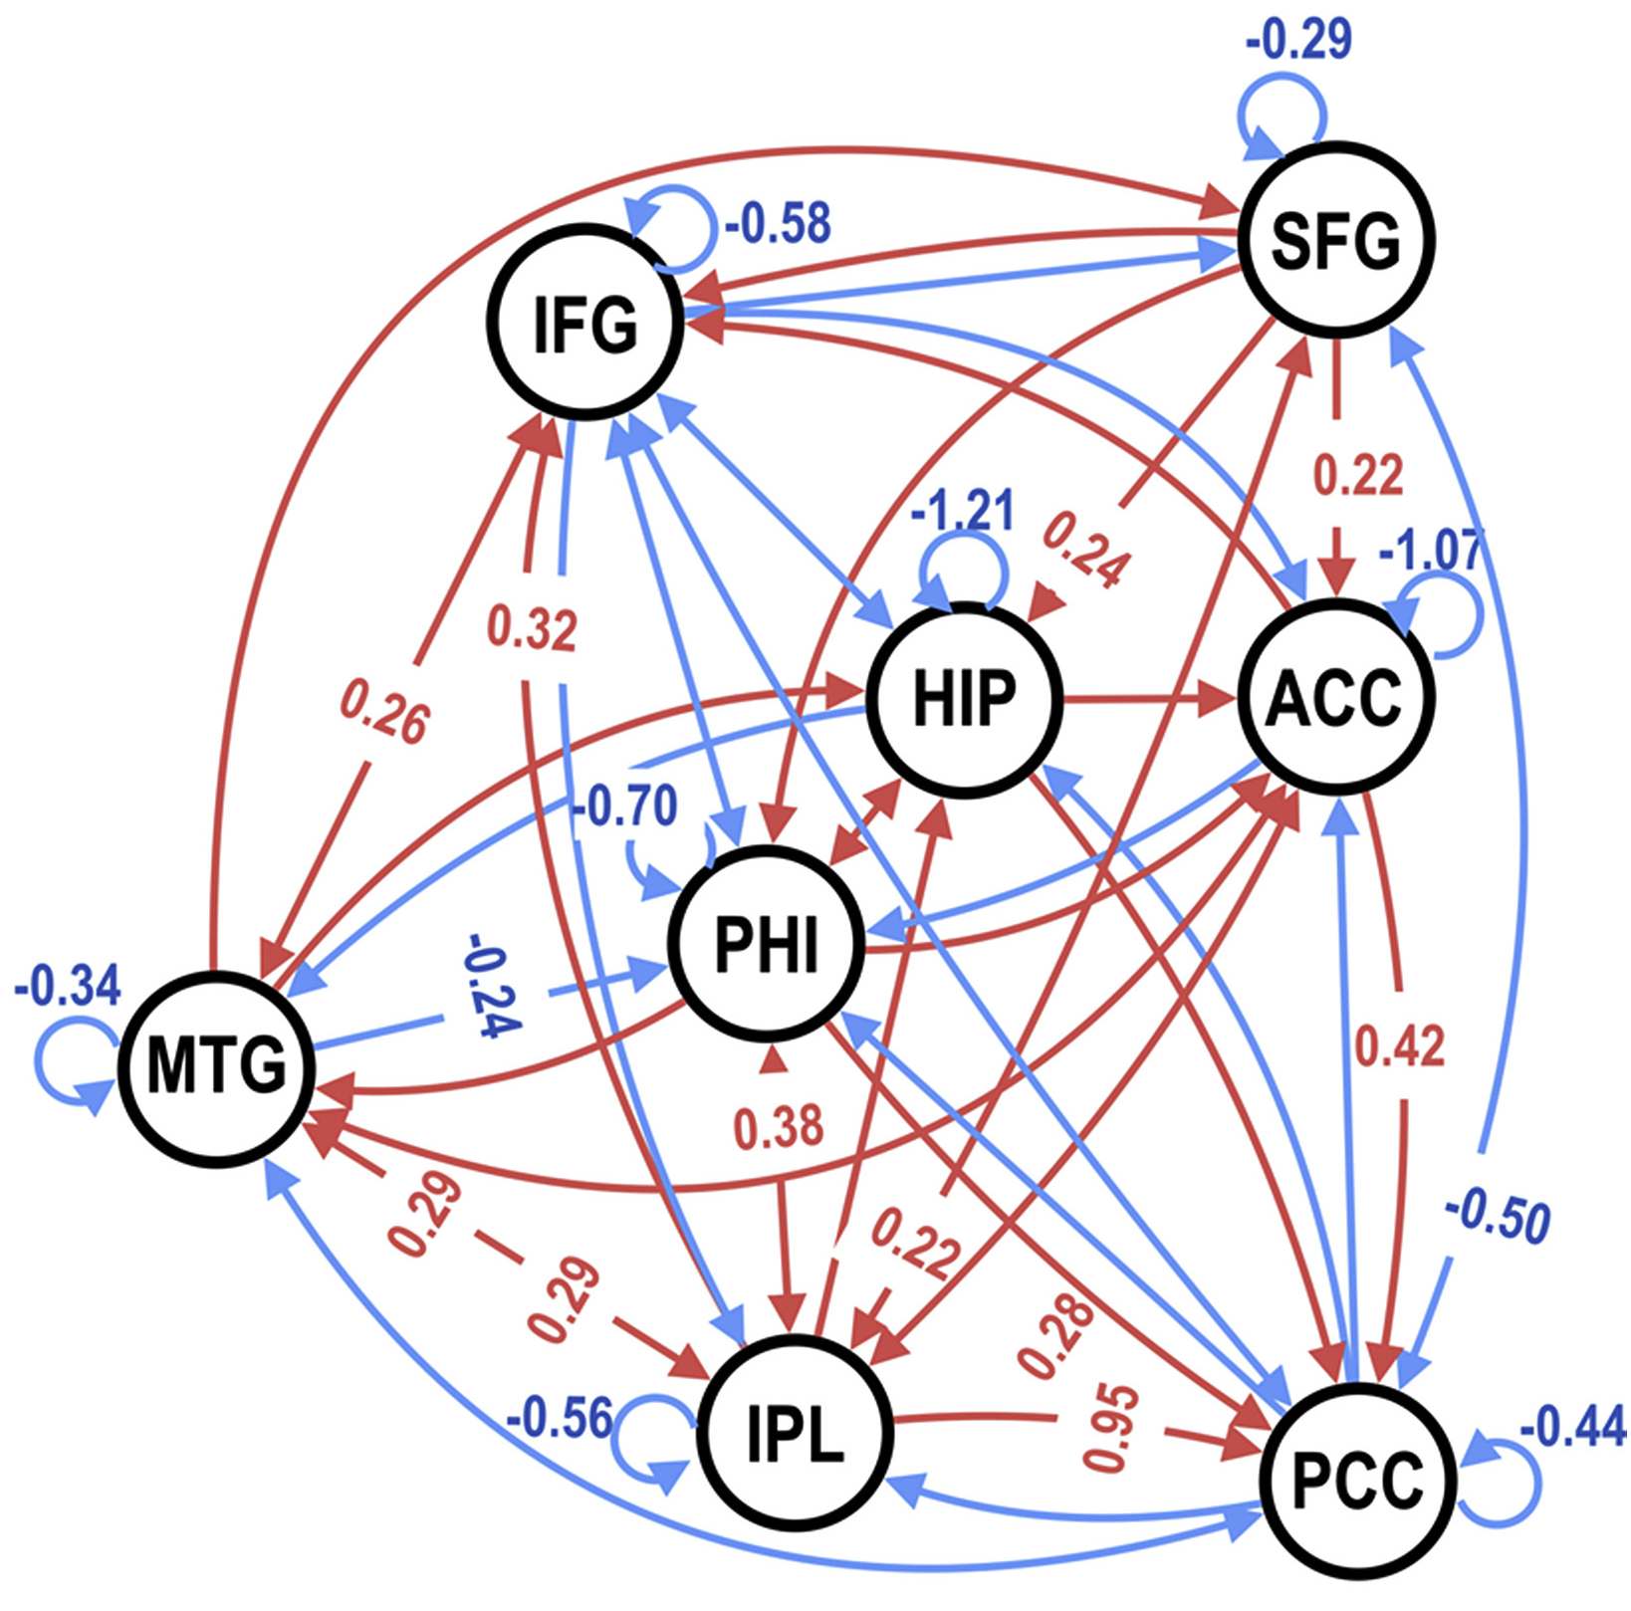
Brain information processing characterize Altered State of Consciousness:
a computational modelling framework
Disorder of Consciousness Anaesthetized Sleep
Magnetic Resonance Imaging (MRI)
Brain Structural MRI (i.e., DTI)
Brain function MRI (i.e., fMRI)
Brain Information Processing
In-silico Perturbation
Brain Connectivity @
Consciousness
Storage
Stability
Whole
Brain
Modeling
Transfer
broadcast
receiving
Brain Connectivity @
Un-Consciousness
Bifurcation
parameter
Brain regions → Brain regions →
Unbalance System Balance System
Causal regional interaction
Hopf oscillator: Local Dynamics
Brain regions →

Slide 3
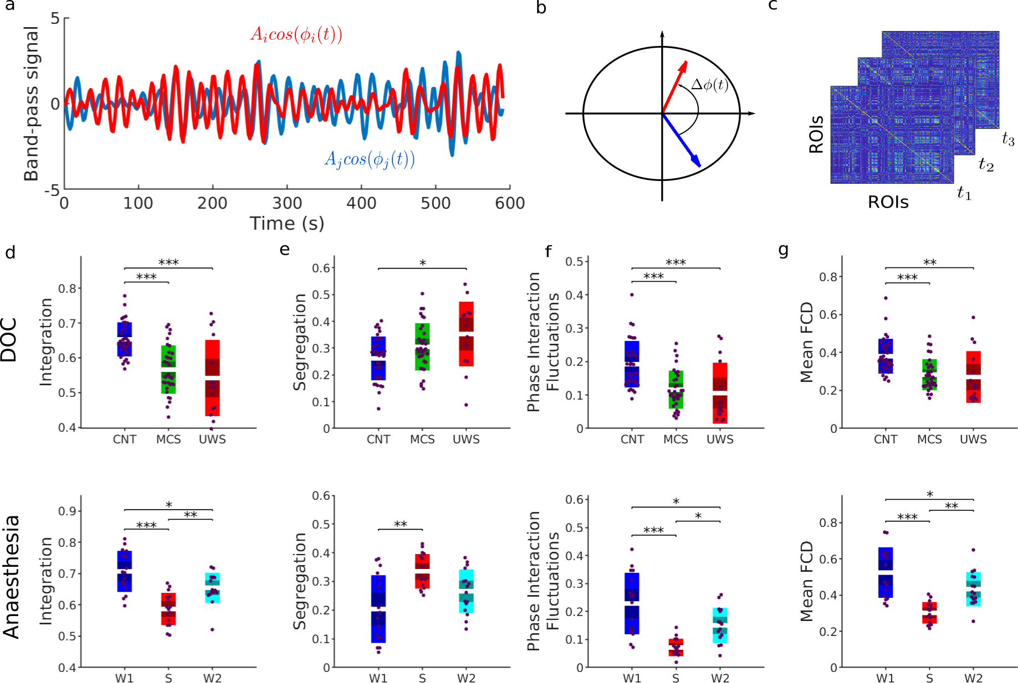
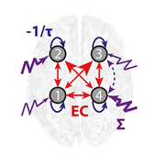
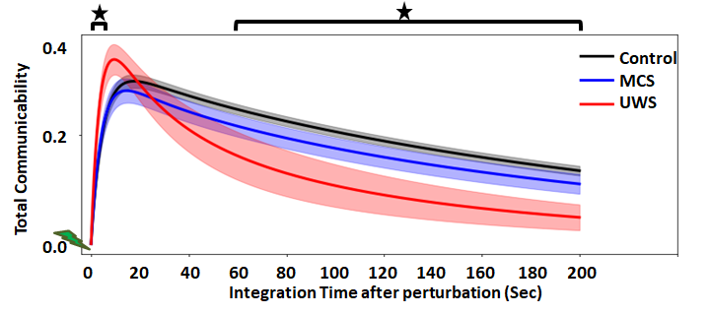
Brain Stability and Information Processing
Phase dynamics complexity
Information Processing
UWS vs DOC
UWS vs DOC
Metastability
In – Communicability
(Receiving Information)
Out – Communicability
(Broadcasting Information)
Figure 1: phase dynamics complexity
>> brain signal @ loss of consciousness
Less Intgrated
More Segrigated
Less Stable
Weeker network coupling
Figure 1: Communicability
>> Information Flow @ loss of consciousness
Low Communicability
Early hyper comonacability
Posterior región loss for receivin info.
Subcortical and temporal región loss for broadcasting info.

