Slide 1
Neural responses to sounds in patient with disorders of consciousness
Estelle Bonin
PhD Student & Neuropsychologist
GIGA Consciousness, Coma Science Group
University of Liège
ExpORL, Neuroscience Departement
KU Leuven
estelle.bonin@uliege.be
estelle.bonin@kuleuven.be

Slide 2
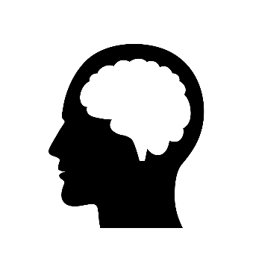
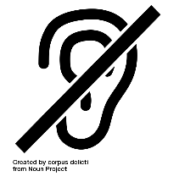
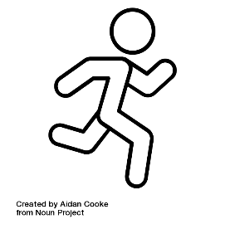
?
+
Treatment according to the diagnosis
Speaker 1
‘Yes’
Speaker 2
‘No’

Slide 3
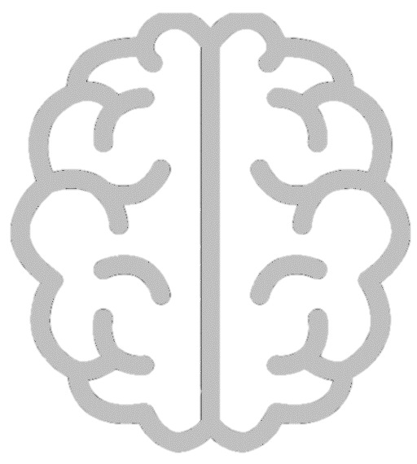
Any question?

Slide 4
Part I Assessment of the auditory pathway
Simple sounds
Differents frequencies
3 Hz Auditory cortex
40 Hz
100 Hz Brainstem
Part II Decoding brain responses to speech
Part III Auditory-attention detection task
2 competing talkers
Training phase: focus attention specific talker
Testing phase: Yes/no question
Neural speech tracking
(correlation)
EEG signal
Speech envelop
Speaker 1
‘Yes’
Speaker 2
‘No’

