Slide 1




Neuroimaging and molecular imaging
E. Salmon

Slide 2


What is neuroimaging?
Can we measure brain metabolic activities ?
Can we see the locus coeruleus in vivo with neuroimaging ?
Can we measure connectivity in brain networks ?
Can neuroimaging be used as biomarker for brain diseases ?

Slide 3
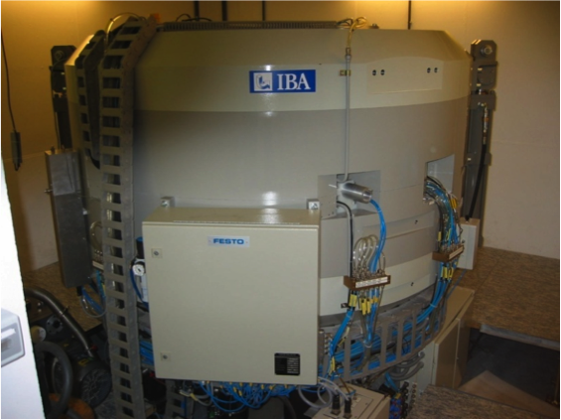
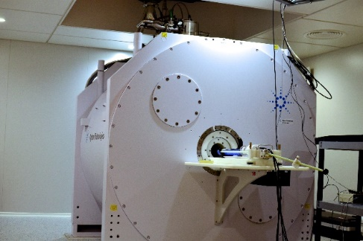
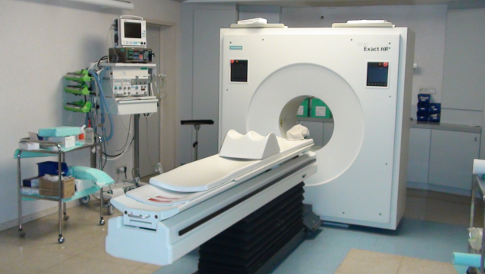
What is neuroimaging?
Cyclotron, Radiochemistry,
GMP radiosynthesis
Preclinical Imaging
(rodents)
Human Imaging

Slide 4
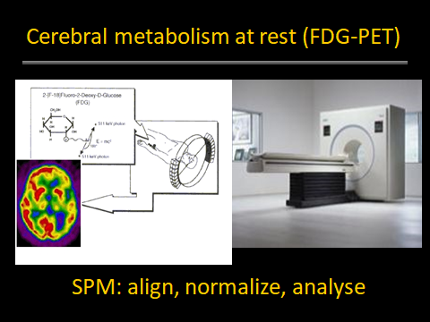
What is Positron Emission Tomography?

Slide 5
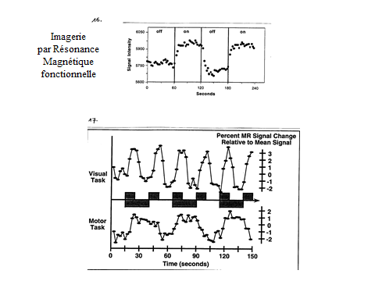
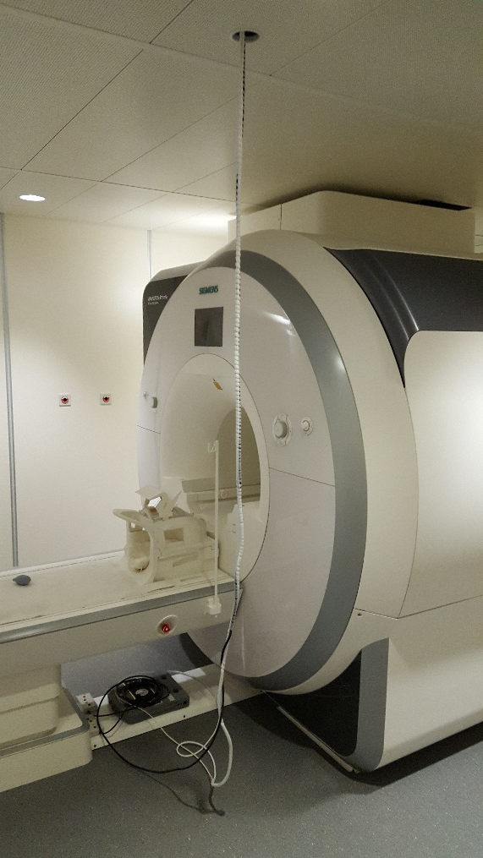
What is Magnetic Resonance imaging?
BOLD:
Blood-
oxygen-
level
dependent
imaging

Slide 6
What is Dementia?
Neuroscience: Decrease of cognitive and/or behavioral abilities
suffisant to interfere with daily life activities
(other meanings in legal, societal language)

Slide 7
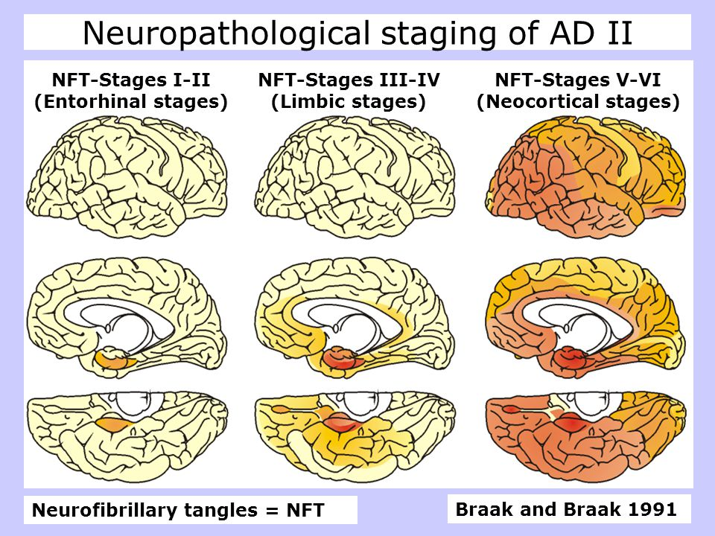
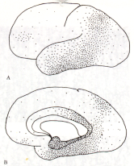
Post mortem brain lesions in AD
Brun and Englund, 1986

Slide 8
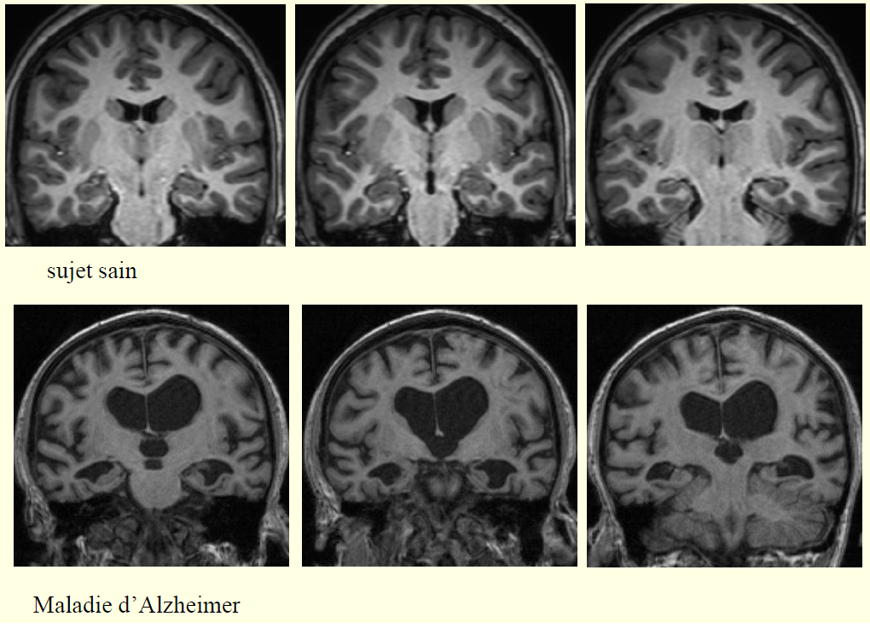
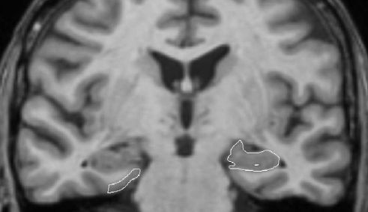
Brain atrophy with MRI in AD
Entorhinal cortex (EC) and Hippocampus

Slide 9
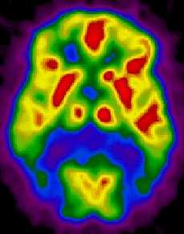

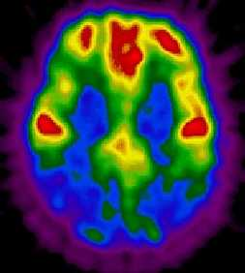
PET-FDG in AD
HC
AD

Slide 10

SPM analysis of PET-FDG in AD
Posterior Cingulate Cortex (PCC)
Statistical Parametric Mapping

Slide 11
Memory & PET-FDG in AD
Grober et Buschke
Semantic association category - item (n=16)
p.ex. flower
tulip
free recall

Slide 12
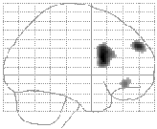
Memory & PET-FDG in AD
Correlation between free recall and frontal glucose uptake

Slide 13
Memory & PET-FDG in AD
Grober et Buschke
Semantic association category - item (n=16)
p.ex. flower
tulip
free recall
Cued recall
flower ?

Slide 14
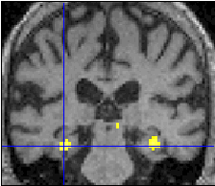
Memory & PET-FDG in AD
Correlation between cued recall and medial temporal glucose uptake

Slide 15
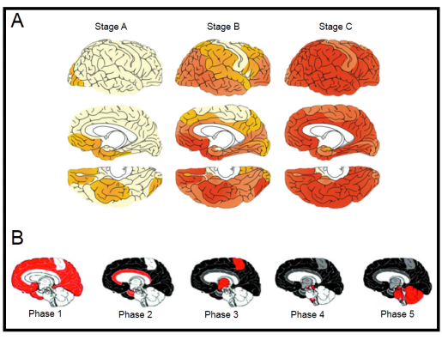
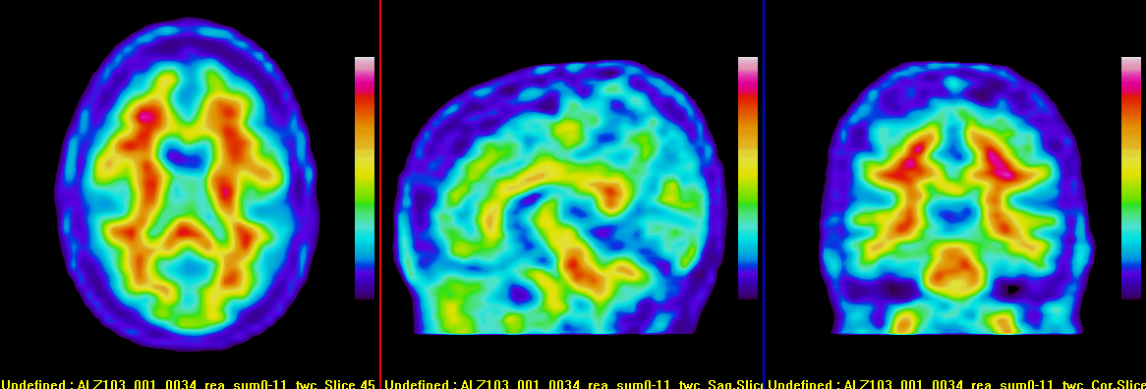
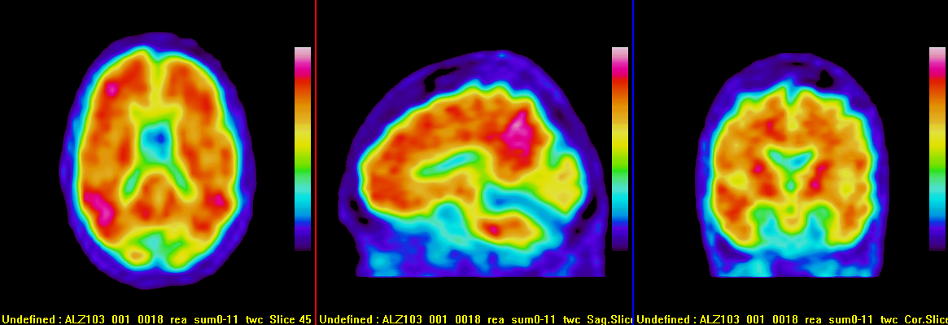
PET-amyloid in AD
Frontal
PCC

Slide 16
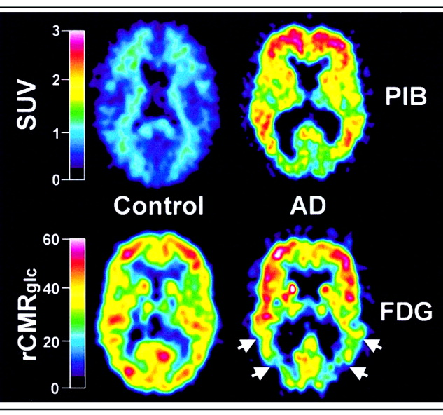
PET-amyloid in AD
Questions:
Accumulation of amyloid in the brain of healthy controls: Cognitive Reserve
No brain amyloid in clinically probable AD patients: Suspected Non Alzheimer Pathology

Slide 17
Activation and interaction in brain memory networks
Papez circuit and episodic memory (memory for events, while remembering context and emotion)

Slide 18
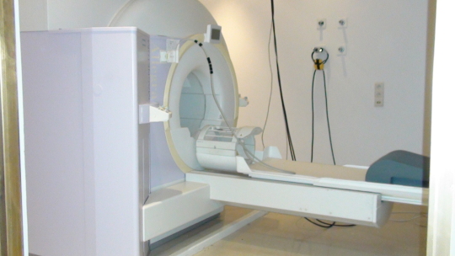
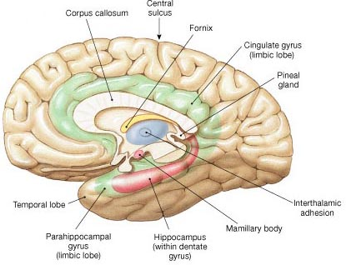
Activation and interaction in brain memory networks
Functional MRI
(BOLD signal)
Brain activation and episodic memory

Slide 19
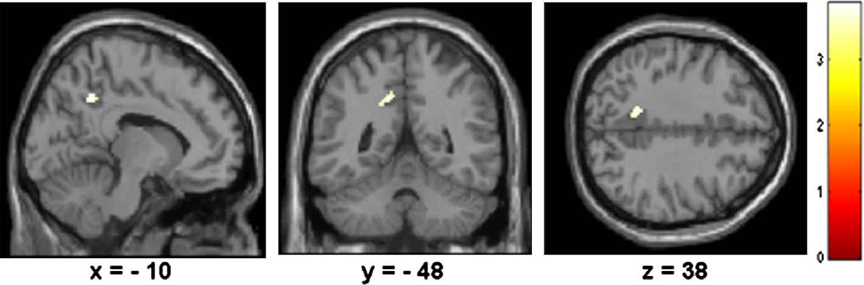
Brain activation in a memory task:
PCC in both AD patients & Healthy Controls
Activation and interaction in brain memory networks
How & where does brain activity differ?
Psycho-Physiological Interaction (PPI)
Genon et al, 2013

Slide 20
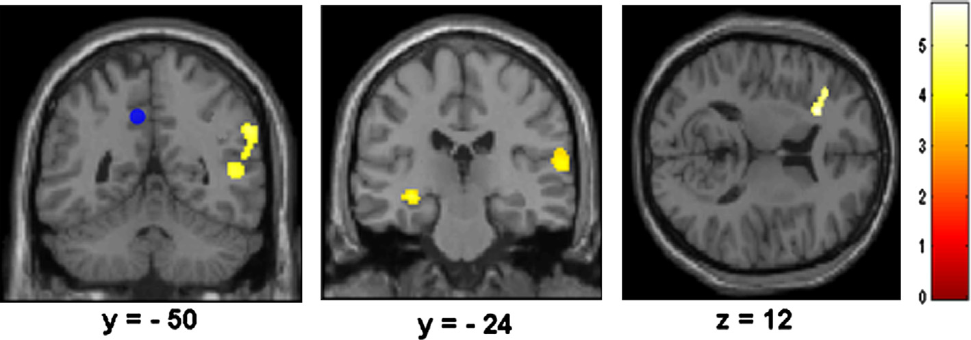
Brain deconnection of PCC in a memory task versus rest, in AD patients versus HC
Activation et interaction des réseaux de mémoire
PPI

Slide 21
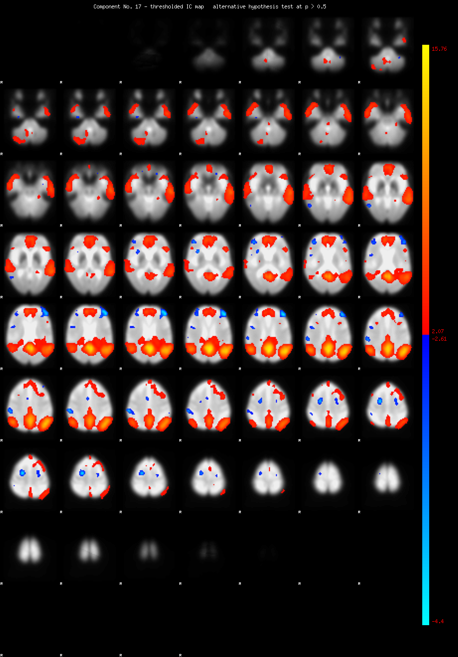
Activation and interaction in brain memory networks
MRI and resting state networks:
covariance in activity

Slide 22
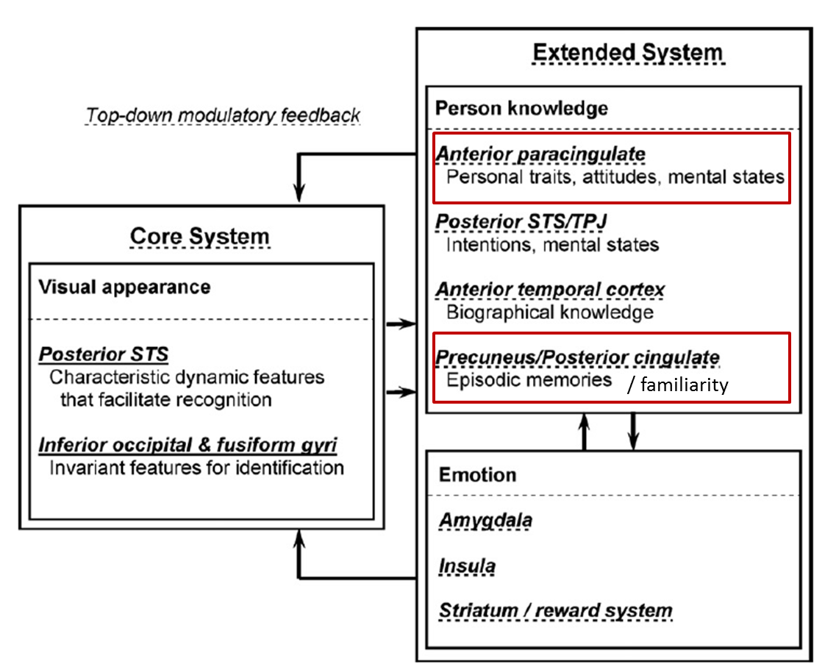
Activation and interaction in brain memory networks
A model for recognition
of familiar faces

Slide 23
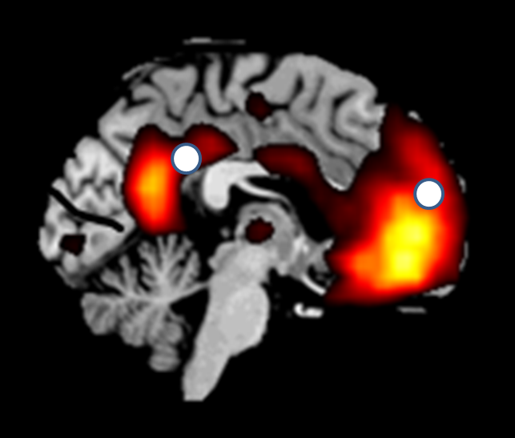
Activation and interaction in brain memory networks
Brain activation for familiar faces

Slide 24
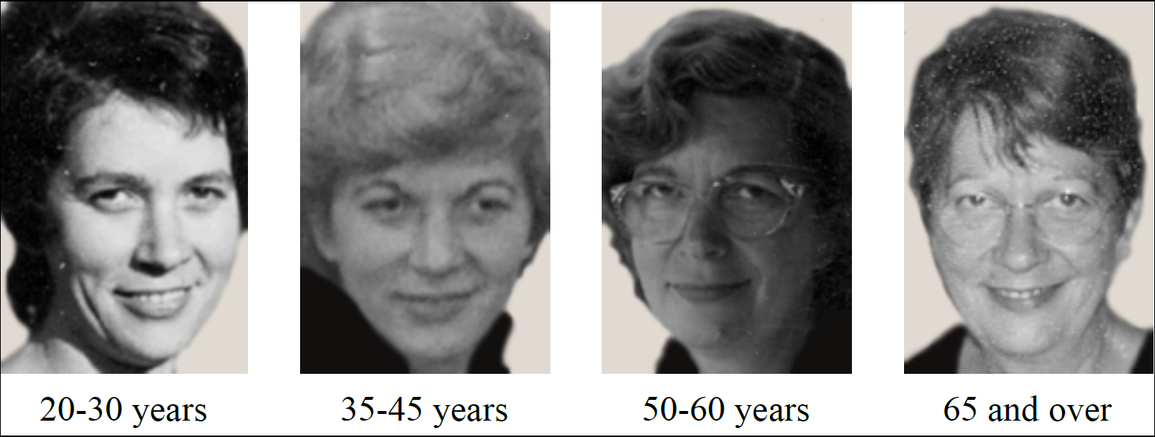
Activation and interaction in brain memory networks
Face recognition: self, relative or other, in AD patients

Slide 25
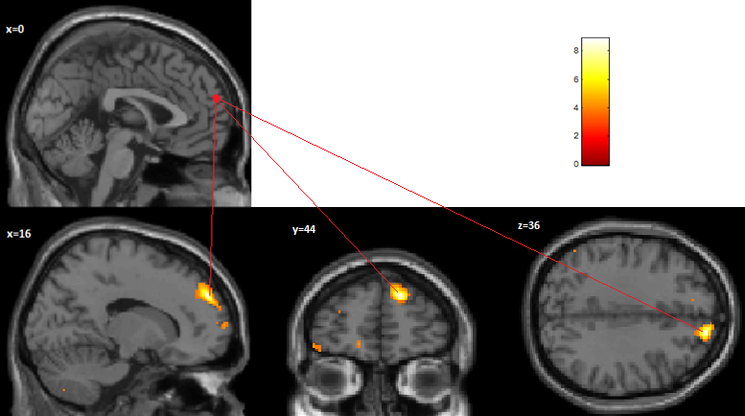
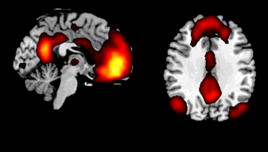
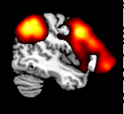
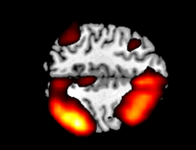
Activation et interaction des réseaux de mémoire
Medial frontal region: brain interaction correlating with face recognition
DMN
Right frontoparietal Attentional Network
Kurth et al, 2015

Slide 26
Activation and interaction in brain memory networks
Higher brain interaction is deleterious for face recognition in AD

Slide 27
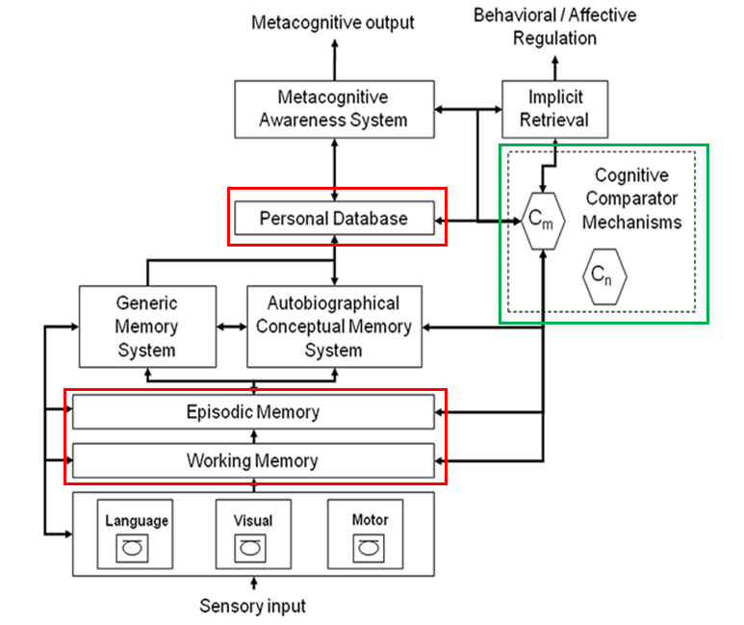
Activation and interaction in brain memory networks
AD and anosognosia
for memory impairment

Slide 28
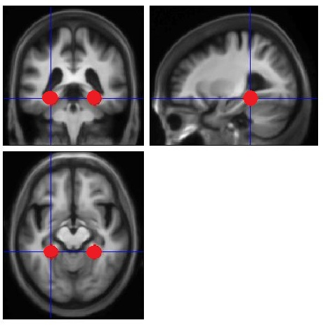
Activation and interaction in brain memory networks
AD and anosognosia for memory impairment: interaction between hippocampal and cortical regions

Slide 29
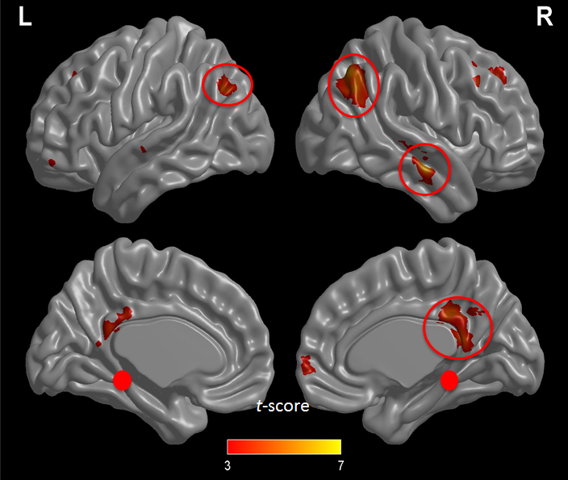
Activation and interaction in brain memory networks
AD and anosognosia for memory impairment: deconnection between hippocampal and cortical regions

Slide 30
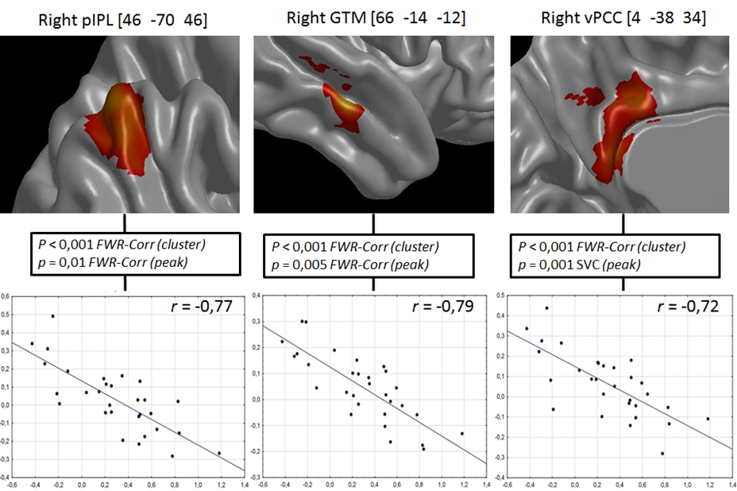
Activation et interaction des réseaux de mémoire

Slide 31
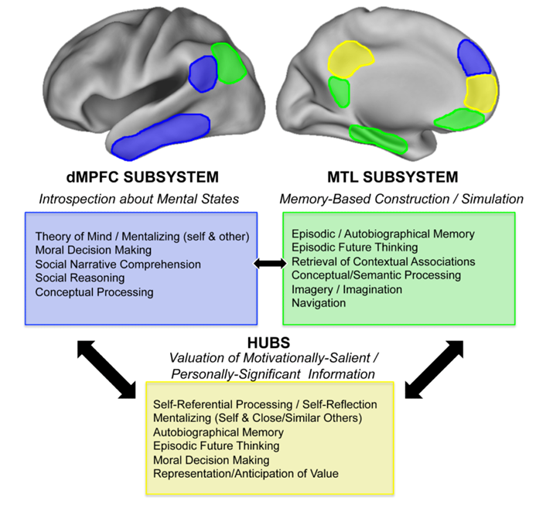
Activation et interaction des réseaux de mémoire

Slide 32
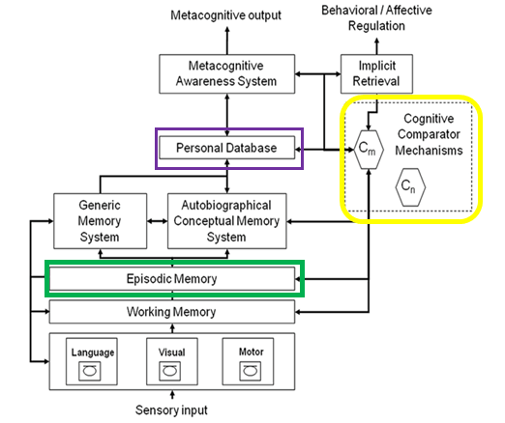
Activation et interaction des réseaux de mémoire
Alzheimer et anosognosie
des troubles
de mémoire
Antoine et al, 2016

Slide 33
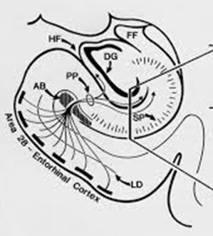
Post mortem brain lesions in AD

Slide 34
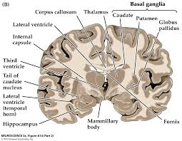

Perforant pathway:
Projection of axons from the entorhinal cortex to the hippocampus

Slide 35
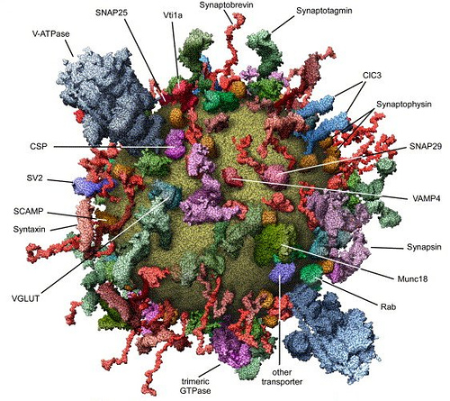
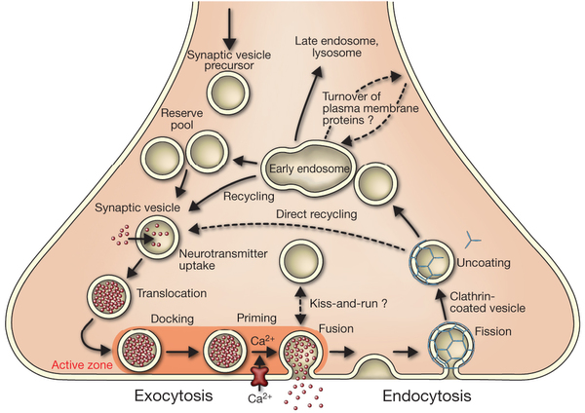
PET-SV2A Imaging for synaptopathy
Synaptic Vesicle 2A protein
SV2A is involved in synaptic vesicle trafficking
SV2A is ubiquitous in the brain
[18F]UCB-H

Slide 36
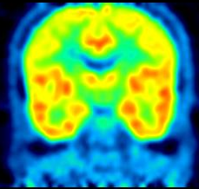
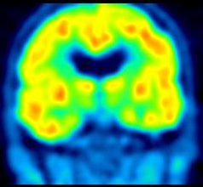
Control
SV2A Imaging in Neurodegenerative Disorders
Mild AD
Visual analysis suggest a decrease in SV2A binding in medial temporal structures

Slide 37
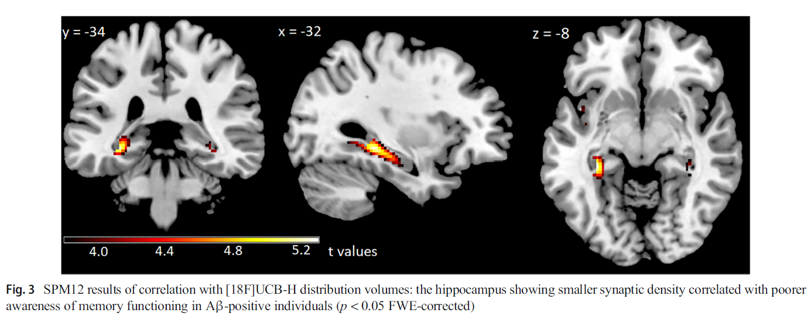
Correlation between memory awareness and synaptopathy in AD

Slide 38
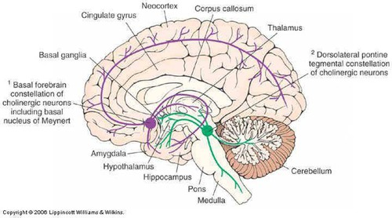
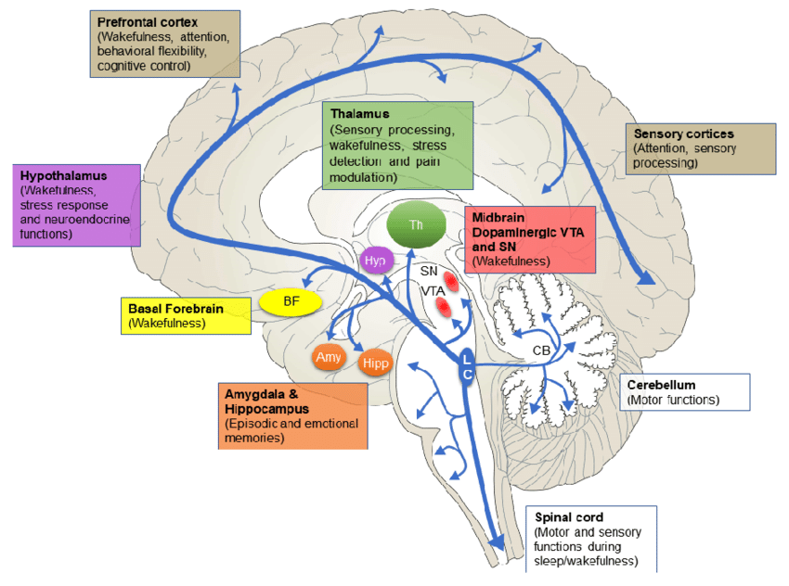
AD and subcortical structures
LC & BF

Slide 39
Self evaluation of cognitive function - AD/PD™ 2020
Background
AD is characterized by a neuropathology that occurs decades prior to cognitive symptom onset.
Initial neuropathology consists of abnormal tau protein accumulation in the brainstem, particularly in the locus coeruleus (Braak and Tredici, Brain 2015).
There is a debate concerning self-assessment of cognitive functioning in preclinical AD.
Some individuals report subjective cognitive decline and they might even show hypernosognosia concerning their relative cognitive changes (Jessen et al, 2014; Vannini et al, 2017).
We searched for a relationship between preclinical self evaluation of cognitive function and AD pathology (brainstem tau deposit) in healthy late middle-aged participants.

Slide 40
Self evaluation of cognitive function - AD/PD™ 2020
Material & Methods
^{[18F]}THK5351 PET was used to measure tau burden in a sample of 66 late middle-aged healthy individuals (50-70 y).
An average PET image was created using the four frames corresponding to the time window between 40 and 60 min after intravenous injection. We used a brainstem mask that encompassed monoaminergic grey matter including locus coeruleus and raphe nuclei. Standardized uptake value ratio (SUVR) was calculated using the cerebellum as the reference region (Lockhart et al, 2016).
Participants followed a complex protocol from which we used age, education, free and cued recall, McNair and Kahn self-assessment of cognitive difficulties, depression and anxiety scales, searching for correlations with brainstem tau burden.

Slide 41
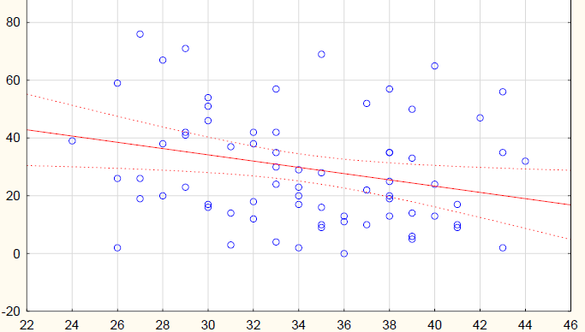
Self evaluation of cognitive function - AD/PD™ 2020
Results
R2 =.07 p<.05
Subjective memory difficulties
R2 =.03
Free recall (memory task)

Slide 42
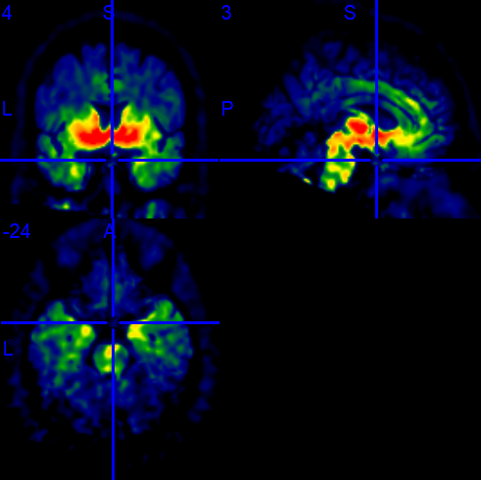
Self evaluation of cognitive function - AD/PD™ 2020
Results
^{[18F]}THK5351 PET brain uptake image, corrected for partial volume effect, cerebellum as reference region.
Notes:
CB: A la place de COF083, pour désigner le participant illustré ici, cela pourrait être chouette de préciser son genre et son âge.
Si possible, tu pourrais supprimer la croix qui parasite un peu l’image.

Slide 43
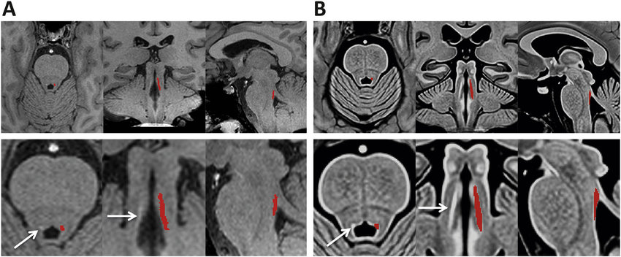
Self evaluation of cognitive function - AD/PD™ 2020
MRI Segmentation of the Locus Coeruleus

Slide 44
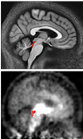
Self evaluation of cognitive function - AD/PD™ 2020
Results
Dorsal mesopontine tegmentum region (comprising the locus coeruleus) defined on MRI
Same region on ^{[18F]}THK5351 PET image

Slide 45
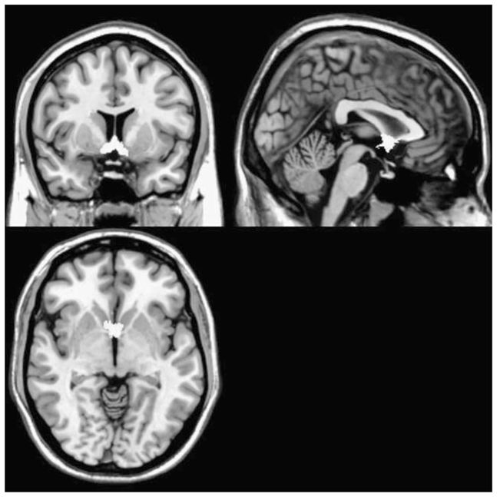
Self evaluation of cognitive function - AD/PD™ 2020
Results
Basal forebrain mask (Zaborszky et al., NeuroImage 2008)
Another region with early AD pathology.

Slide 46
Self evaluation of cognitive function - AD/PD™ 2020
Results
Regression analysis revealed that entering brainstem or basal forebrain tau burden in addition to cognitive variables did not explain self-evaluation of cognitive functioning.

Slide 47

FrontoTemporal Lobar Degeneration

Slide 48


FrontoTemporal Lobar Degeneration
N AD FTD
18FDG-PET

Slide 49

FrontoTemporal Lobar Degeneration: PCA of FDG-PET

Slide 50
FrontoTemporal Lobar Degeneration
In post-mortem studies, a significant decrease in synaptic density measured with synaptophysin was reported in the superficial layers of the prefrontal cortex of FTLD cases compared with normal controls (Liu et al, 1996). In Pick’s disease, synaptophysin immunoreactivity was also reduced in the outer molecular layer of the hippocampal dentate gyrus (Lippa et al, 2004).
12 patients with probable bvFTD were compared to 12 control participants matched for age, sex and education. Everyday life cognitive functioning and self-awareness were assessed by means of informant-based reports and participants’ reports with the Anosognosia Questionnaire for Dementia (AQ-D) that probes cognitive and behavioral changes (Migliorelli et al, 1995). We used [18F]UCBH-PET (binding to synaptic vesicle 2A or SV2A) to assess the regional loss of synaptic density. Total distribution volume was obtained with Logan method and carotid artery derived input function.

Slide 51



PET-SV2A in FrontoTemporal Lobar Degeneration
N
FTD
>

Slide 52

FrontoTemporal Lobar Degeneration
Loss of synaptic projections was predominant in the anterior parahippocampal gyrus of our bvFTD patients.
This region is part of the limbic network and the perceptive social brain. The result is consistent with uncinate white matter degradation in bvFTD.

Slide 53
What is neuroimaging?
Can we measure brain metabolic activities ? Example?
Can we image the locus coeruleus in vivo ? Which technique ?
Can we measure connectivity in brain networks ? Which techniques ?
Can neuroimaging be used as biomarker for brain diseases ? Example?

Slide 54



